Slide 1


NCW Women Safety Audit Platform
https://uatncwsafety.digitalindiacorporation.in/
Contact Email- shilpi.kumar@digitalindia.gov.in
Digital India Corporation (DIC)
Ministry of Electronics and Information Technology

Slide 2
1. Introduction
National Commission for Women (NCW) intends to conduct Women's safety audits in Indian cities through some selected institution / agency. The objective of the audit is to assess the level of safety experienced by women in public spaces and workspaces in the city based on a sample survey & focused group discussions (FGDs) and to submit a detailed report in this regard.
2. Purpose
The goal of the WSAP (Women Safety Audit Platform) is to collect the safety data through mobile phones and to be uploaded into a centralized server and generate score cards for the city.

Slide 3
Product Features
Web Portal Feature includes fully functional backend which includes interactive preview of dashboards, management of all modules, city Score card based on survey data.
Agency Web Portal is used for all administration related activity of the audit survey. Admin portal will be handling all the modules of the project. The main modules are
- Manage Users and their roles
- Survey management
- Reports
- Analytics
Product Perspective
Mobile App – Surveyor Registration / Login – Perform Survey – Data Collection offline/online – Send to Server
Web Portal Backend – Registration/login of Different level of users – Pre survey data upload- Audit Data – Scoring Mechanism – Reports - Statistics

Slide 4
Perform Surveys
Public Space II
Work Place II
Municipal Corporation II
Police Authorities II
Transport Department II
Focused Group Discussion II
Observation Checklist – Public Space II
Observation Checklist – Workplace II

Slide 5
About the Platform
  Web Application
  Users: The web application is available for two types of user
  Super Admin
  Agency Admin
  Mobile Application:
  User: The mobile application is available for Surveyor

Slide 6
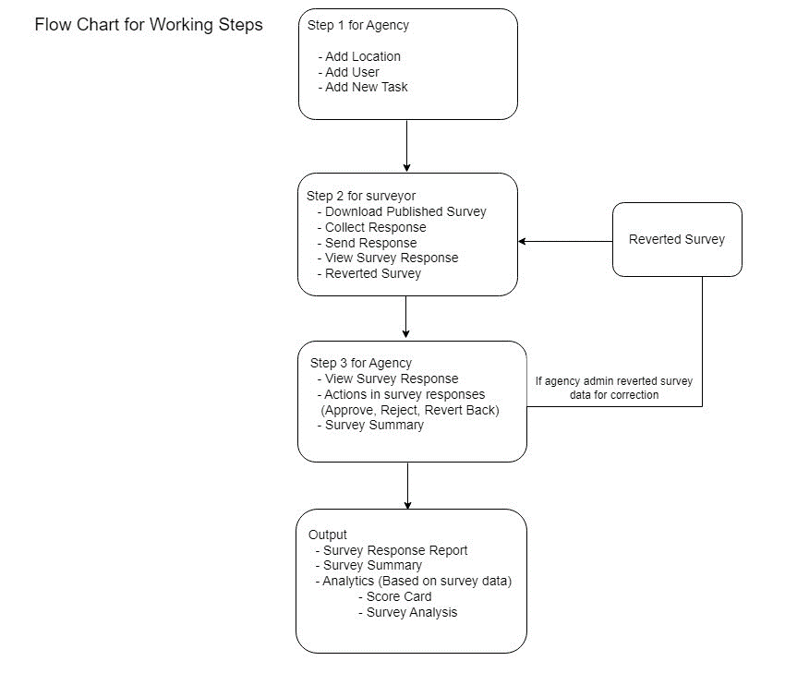
Flow Chart for Working Steps

Slide 7
Process Flow for Agency Admin
Login into web portal -> https://uatncwsafety.digitalindiacorporation.in/
Add Location
Add User
Task Assignment
Report
Analytics

Slide 8
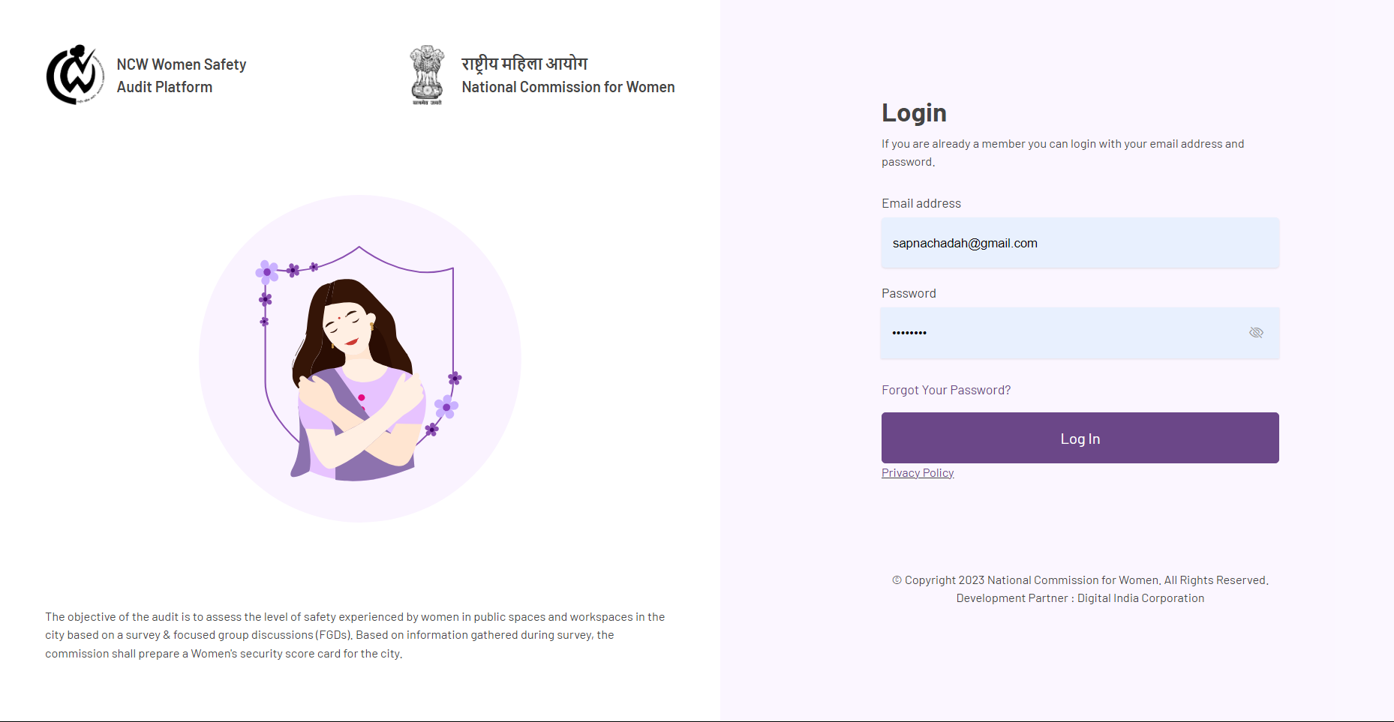
Login Page for Agency Admin – The login credentials of the agencies will be shared by the Super Admin through email.

Slide 9
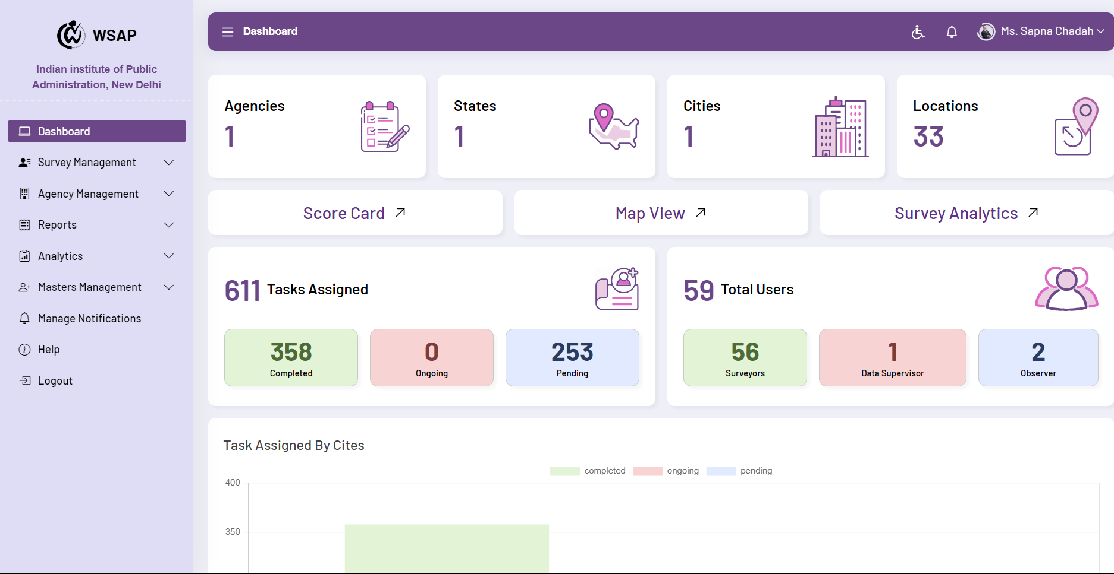
Dashboard for Agency Admin - Agency admin will be manage and monitoring all activities for user like Surveyor, Supervisors and Observer.

Slide 10
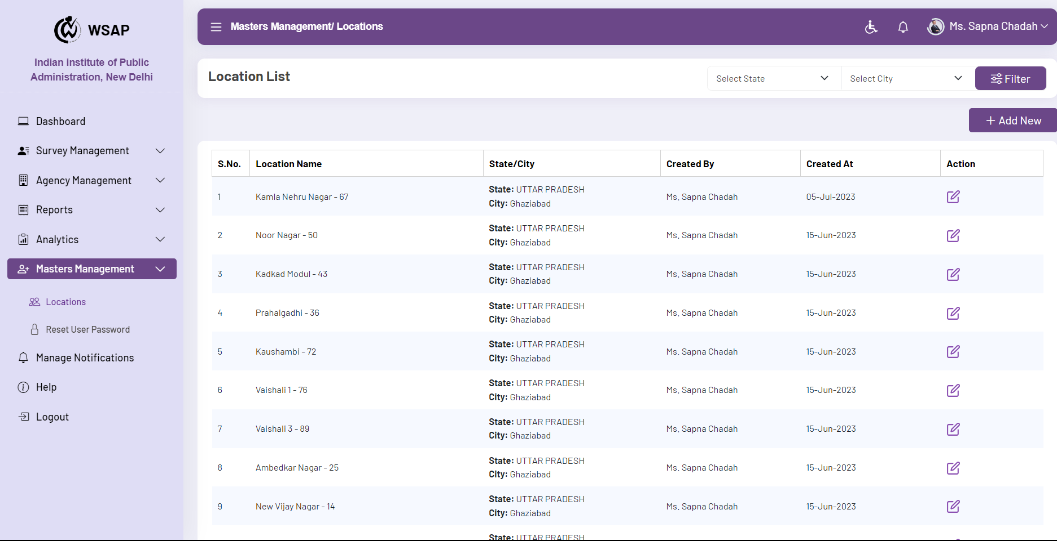
Add Location -
In this section, we will add a new location, the new location to be surveyed.

Slide 11
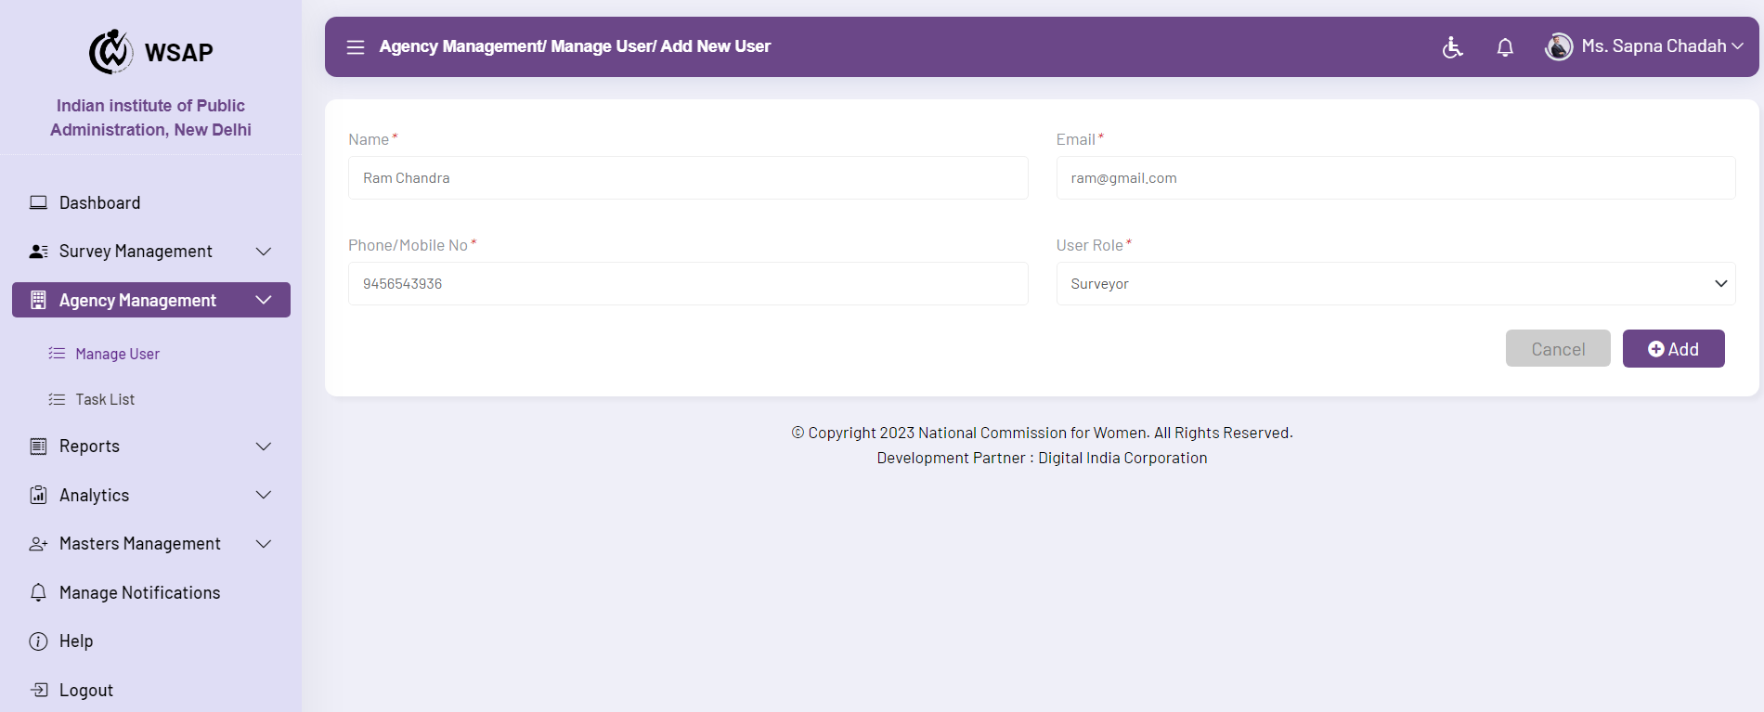
How to Add User-
In this section, we will add a new user.

Slide 12
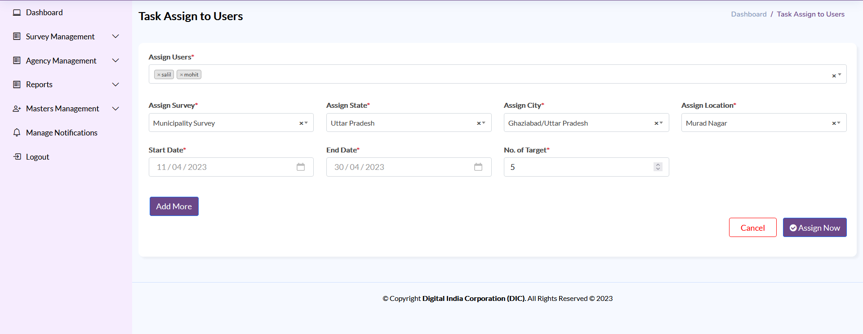
Task Assignment-
Tasks will be assigned to users by this page.
By clicking on the Add More button, more than one survey task can be assigned to the user at a time.
On clicking the Assign Now button, the task will be assigned to the user.

Slide 13
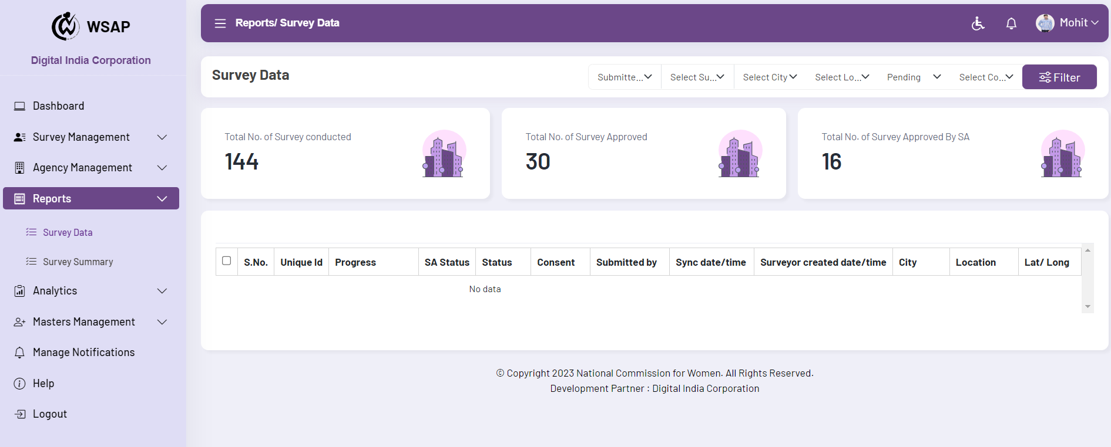
Reports - How to see Survey Response Reports and How to Actions in Responses - you can see survey data and survey summary. Also, you actions (Accepted, Rejected, Reverted).
How to see Survey Response Reports
Survey Data - In the survey data, you can see the answers given by the surveyor and can also accept, reject or revert the survey response based on your decision.

Slide 14
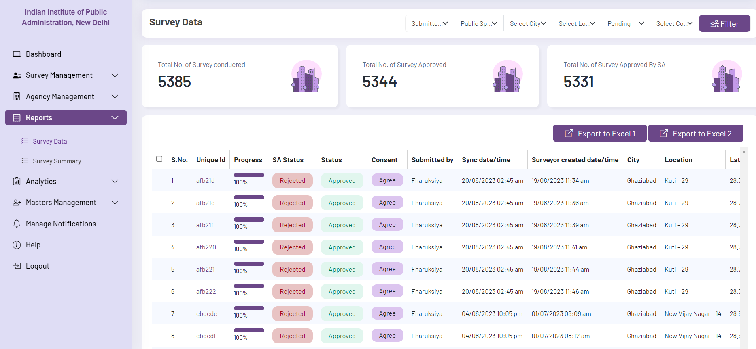
To view survey responses you must select the filters you wish to view
You can view all survey responses in a single page by clicking on the unique ID.

Slide 15
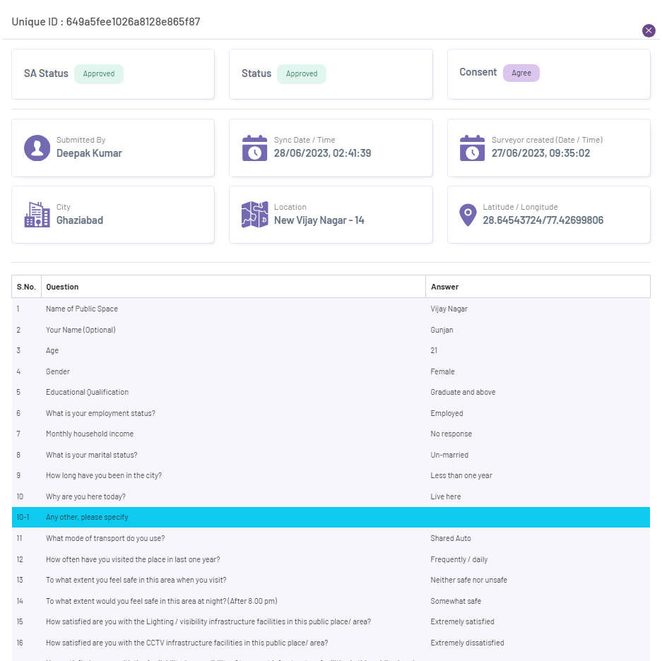
you click on the Unique ID, a page will open in which you will see the responses, from here you have to approve, reject and revert only after checking the data.

Slide 16
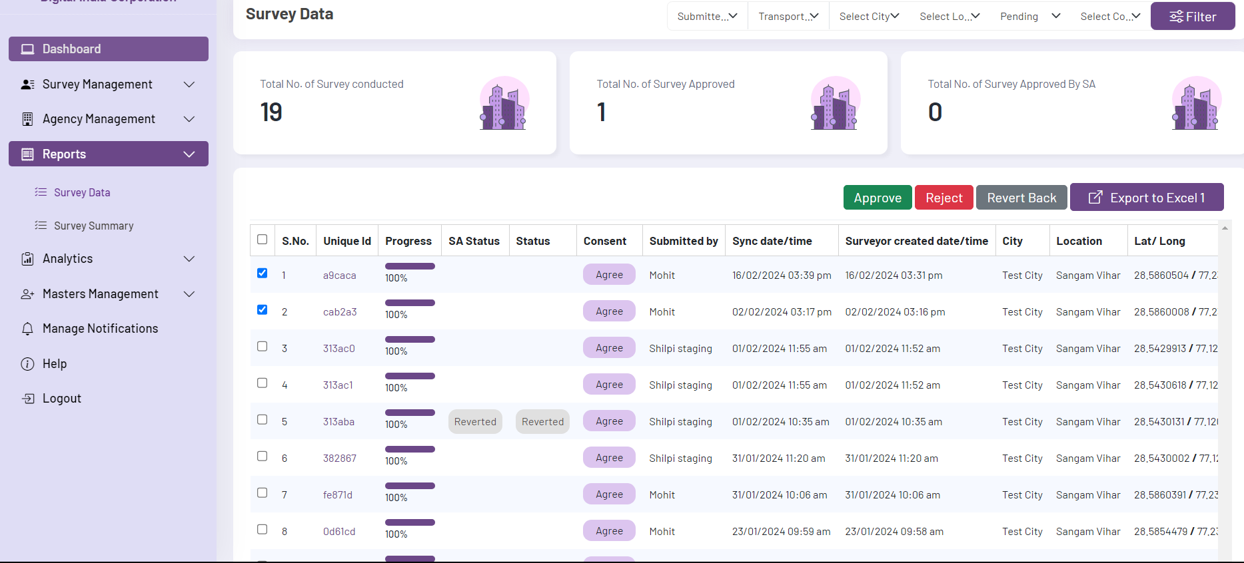
Actions in survey responses (Approve, Reject, Revert Back)- In the survey data, you can see the answers given by the surveyor and can also accept, reject or revert the survey response based on your decision.

Slide 17
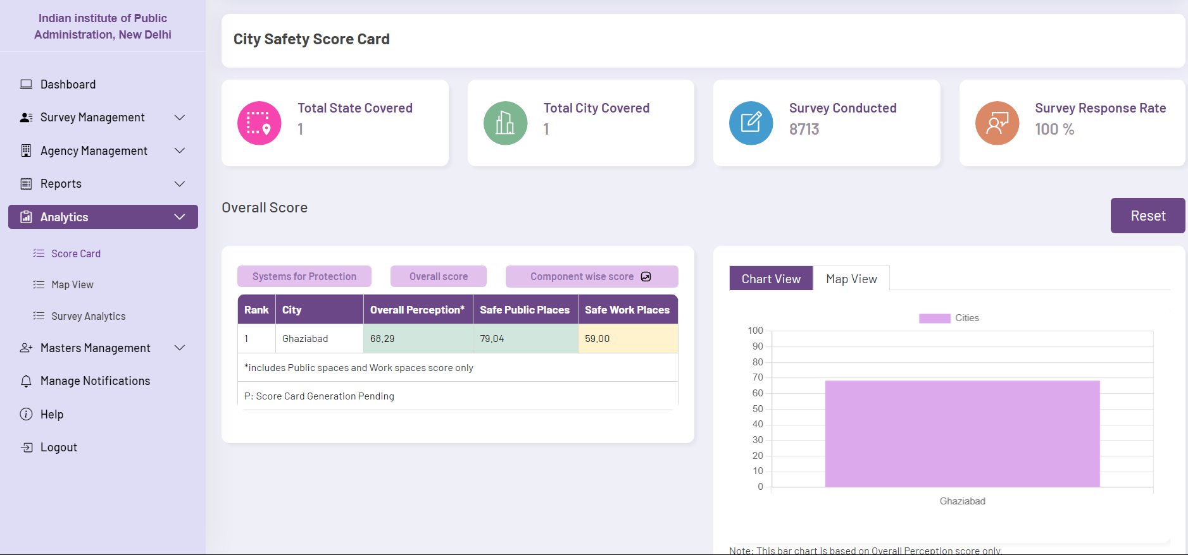
Analytics-
Score Card- The score card of your city will be visible in the score card and on clicking the city the score card of your location will also be visible.
Note: The score card is dependent on the responses given by the surveyor.

Slide 18
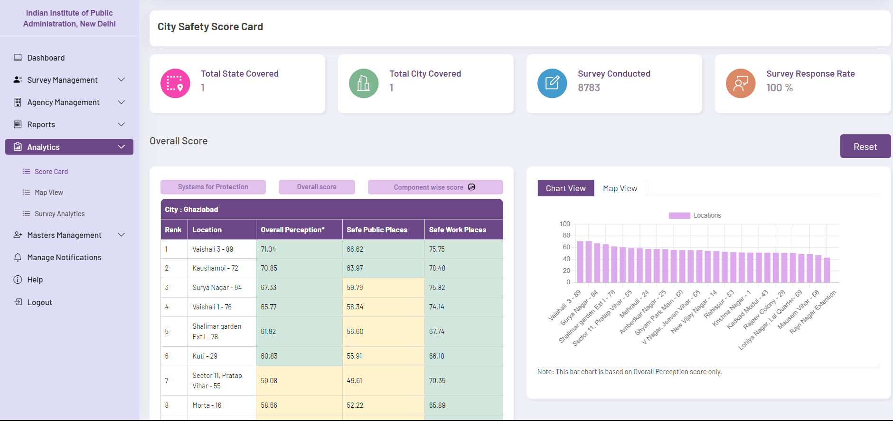
Here you can see the score card of the location in which the survey has been conducted.

Slide 19
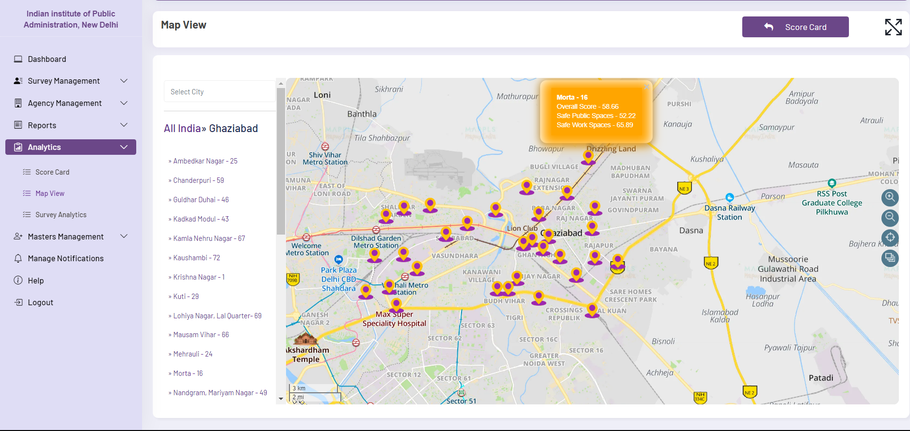
Map View- Here you will see hover over the map with a score card where the survey has been conducted.

Slide 20
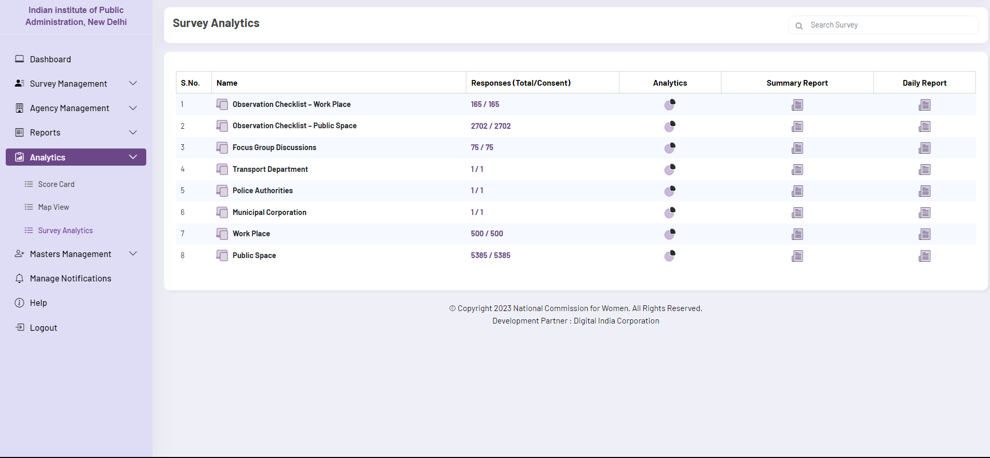
Survey Analytics- Here you can analytics the survey responses

Slide 21
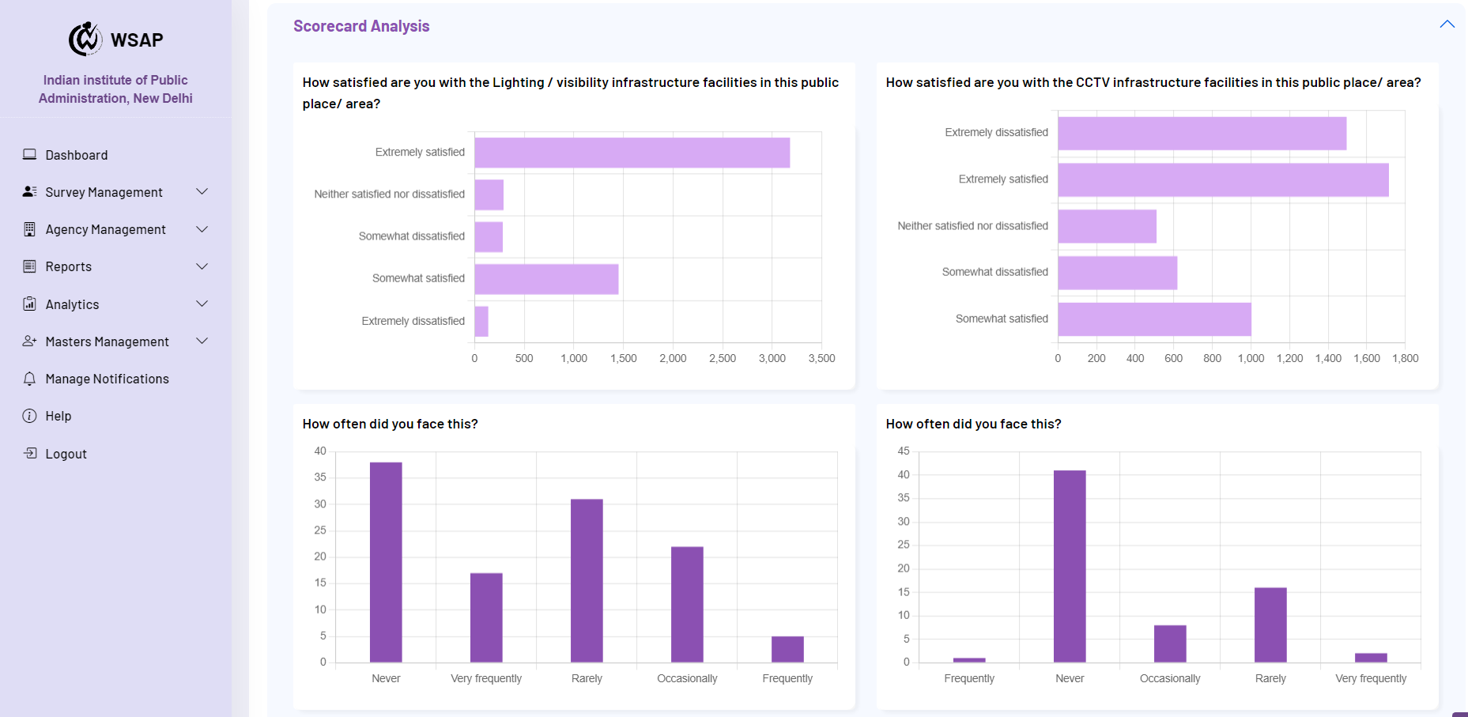
Scorecard Analysis-

Slide 22
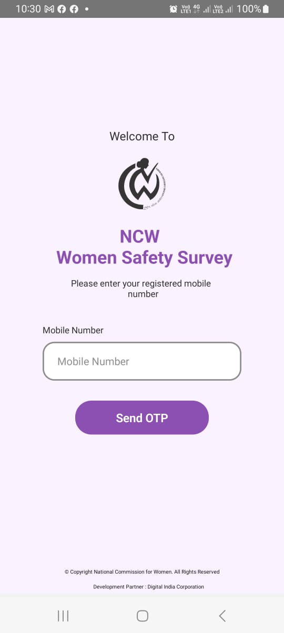
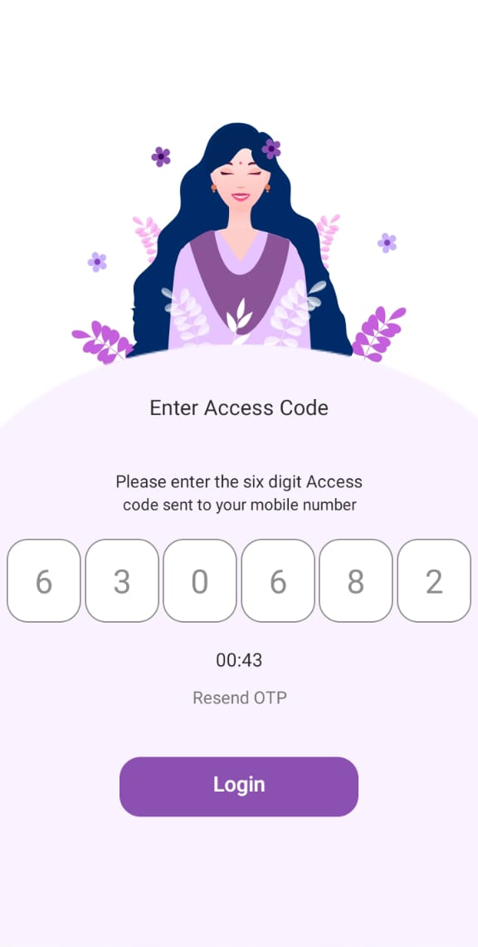
How to Login Surveyor through App
Login through your registered phone number (only Registered by Agency Admin cum PI in the Web Portal)
Login page for surveyor in App

Slide 23
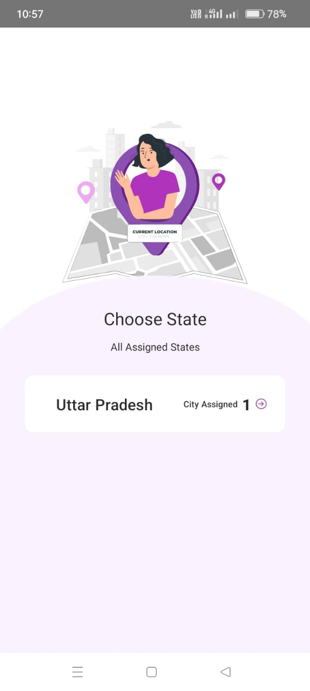
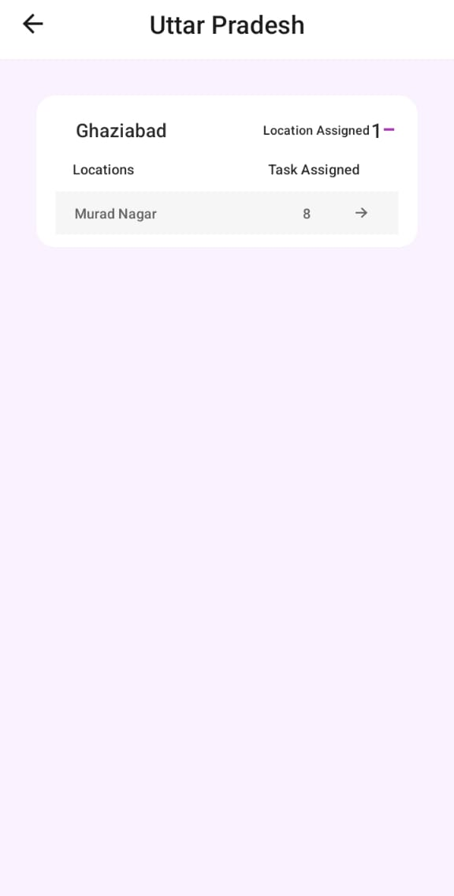
How to Choose Assigned State and Location-

Slide 24
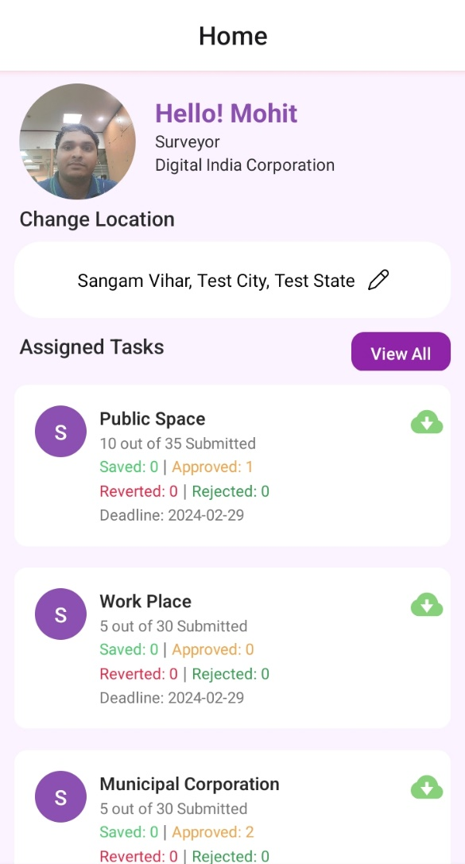
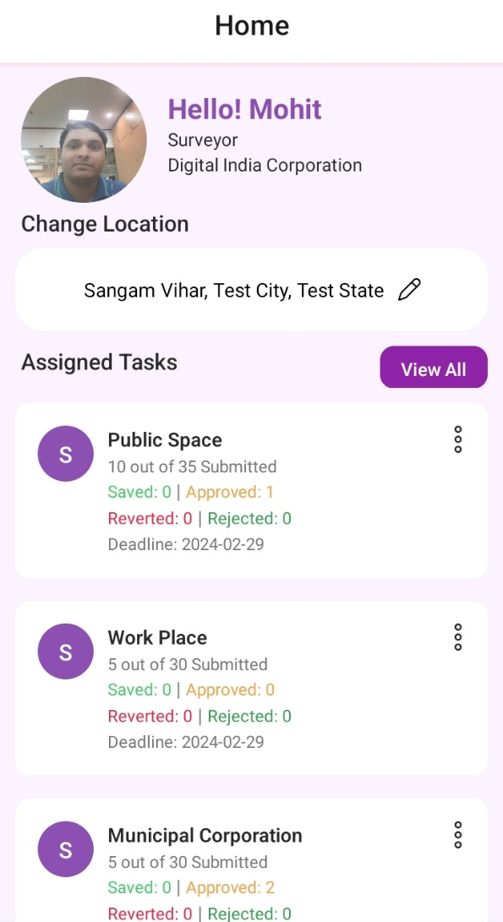
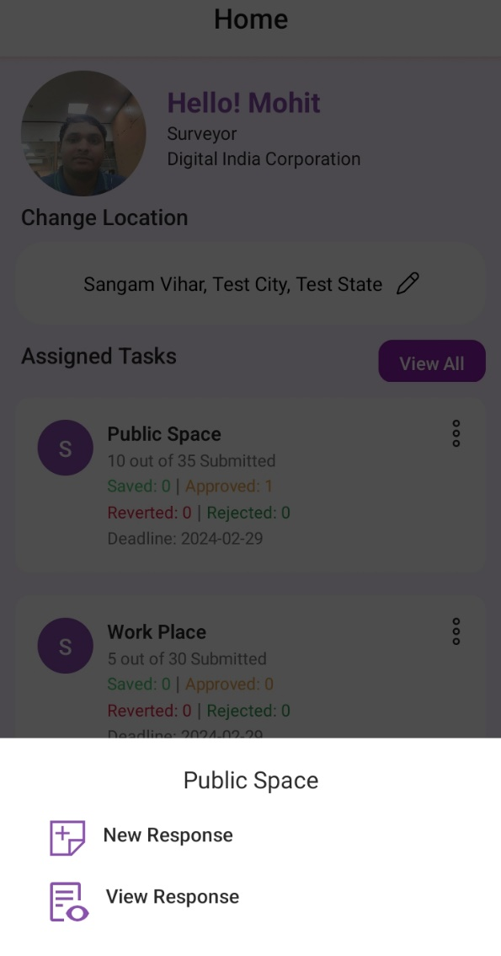
After selecting the Murad Nagar location the survey list will open
If the new surveyor is logging in for the first time on his mobile, then he will have to download the survey first.
Click on the three dots to fill the survey form
Click on the download button, the survey will be downloaded
After clicking on new response, the survey form will open

Slide 25
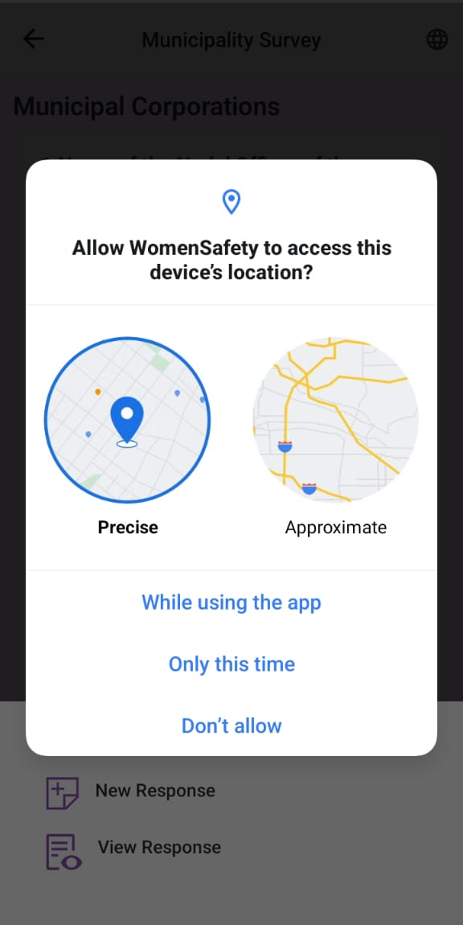
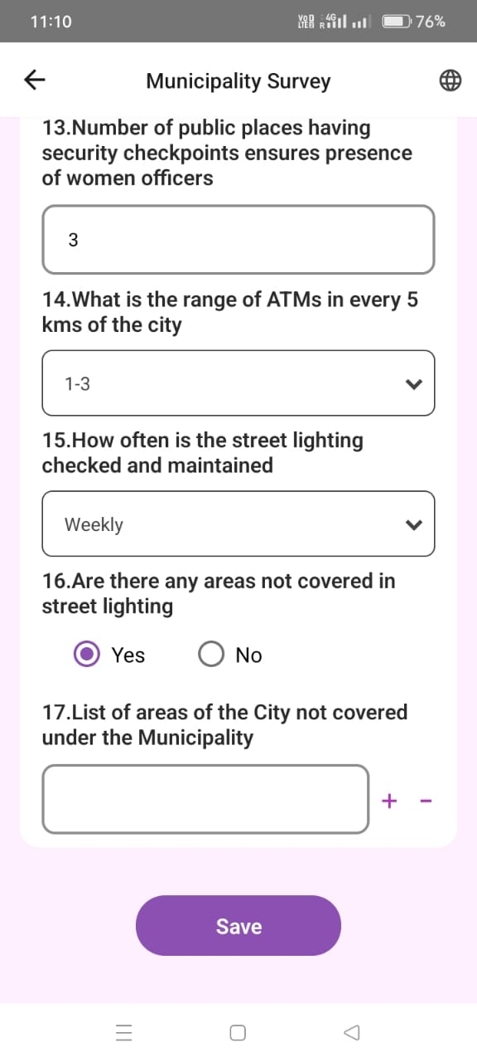
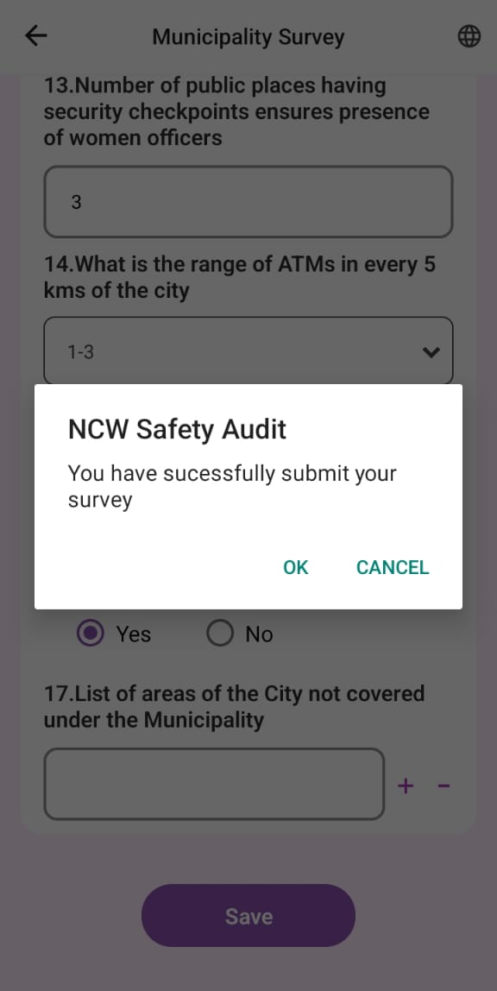
After Click on New Response, App requests to access the device location
If you allow location, this survey form will open
On pressing the save button again, the survey will be saved

Slide 26
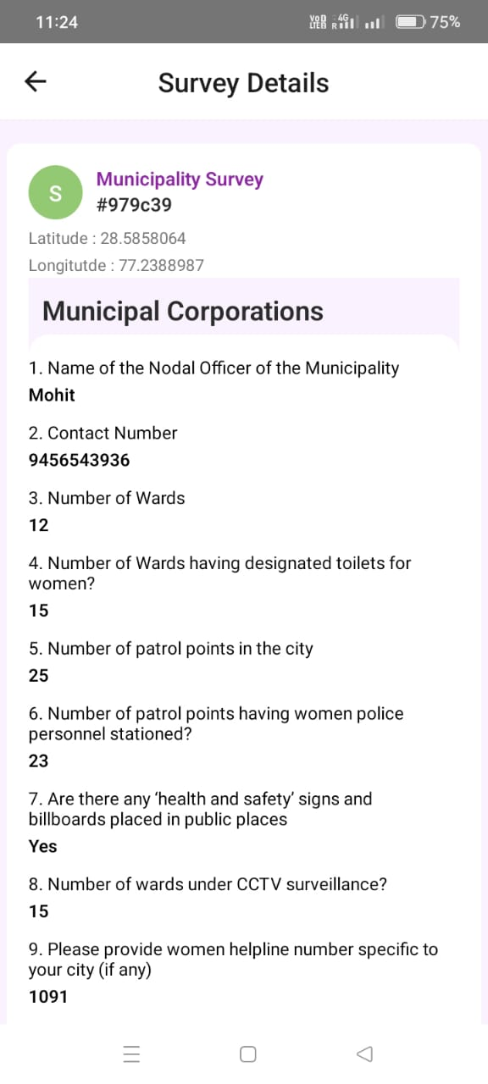
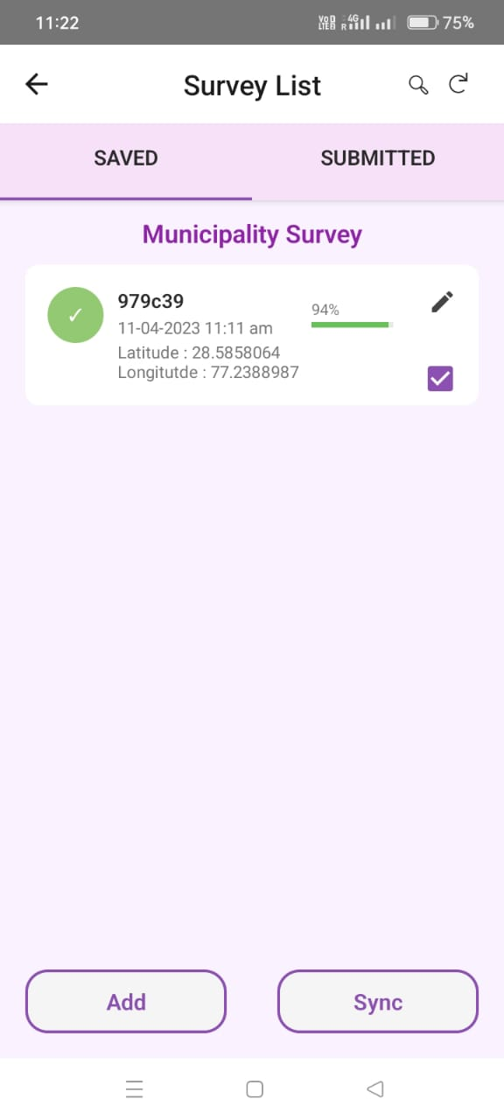
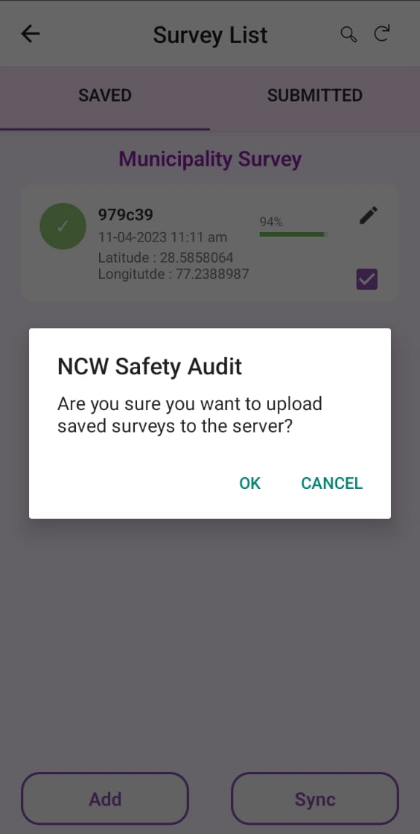
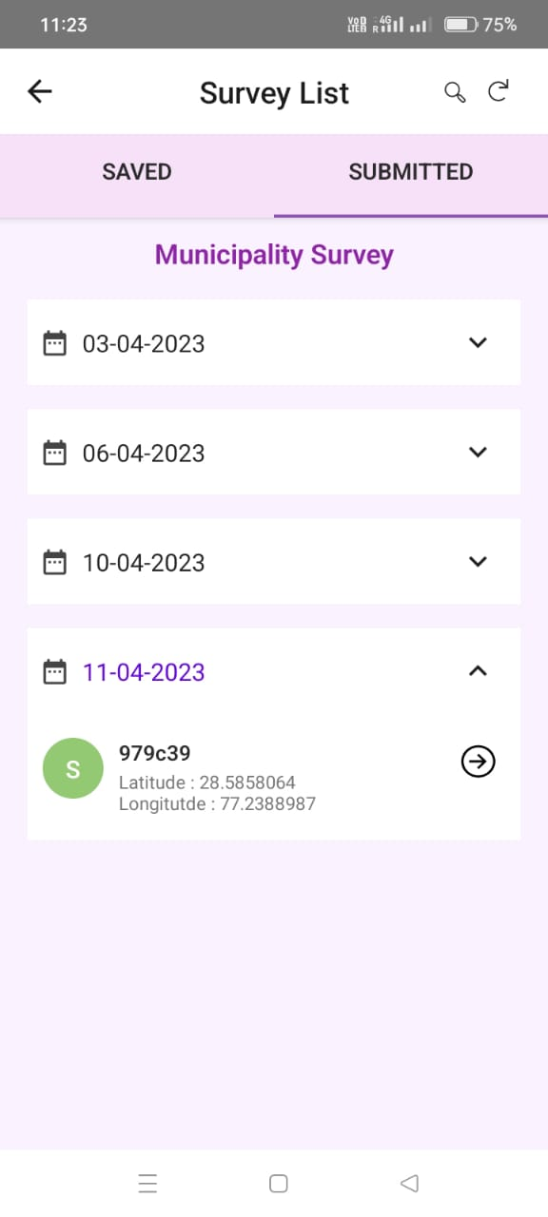
To see the data sent to the server, you have to click on the right arrow.
To send the saved survey to the server, check the checkbox and click the Sync button.
Click Right Arrow

Slide 27
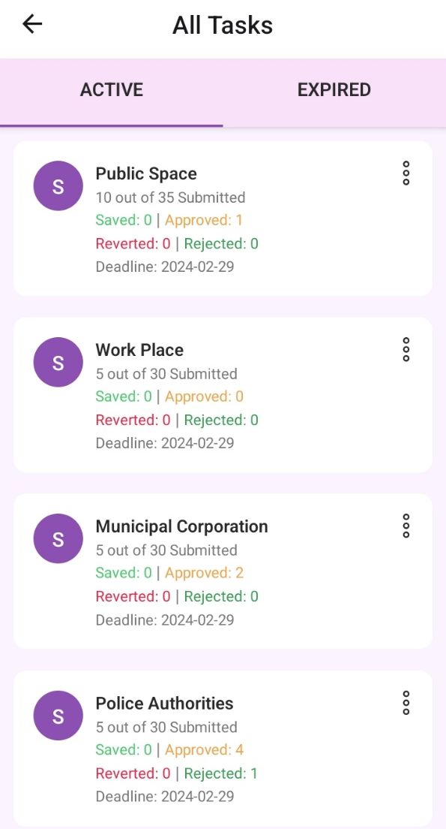
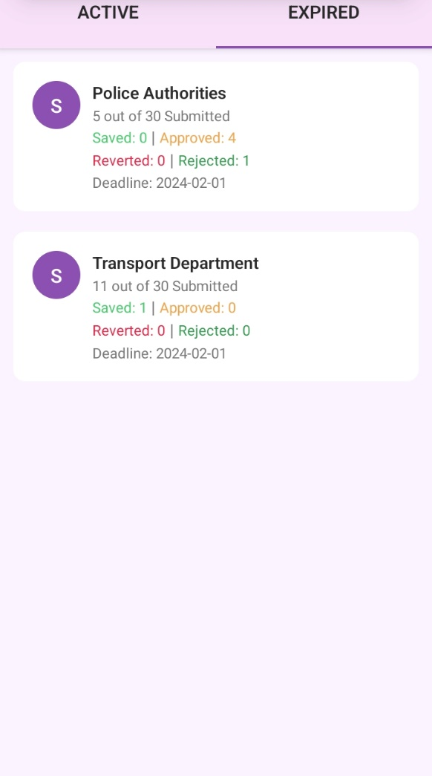
How to View all survey ( Active and Expired survey) -
In the Expired column, you'll see expired surveys, and if you haven't synced your saved surveys for some reason, you can sync but not add a new response.
In Active Survey column, You will be shown the list of currently running surveys.
Click on View All button

Slide 28
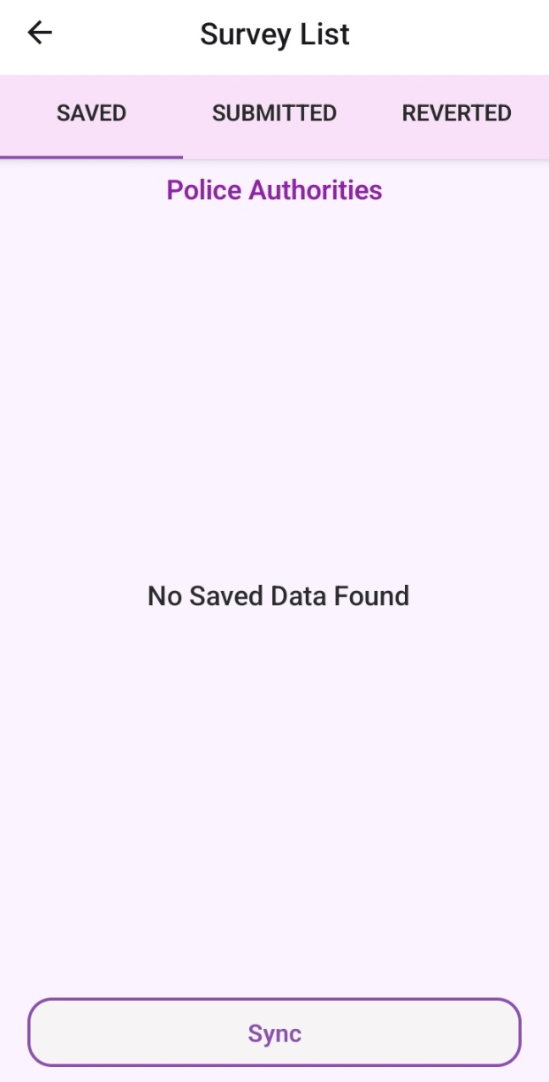
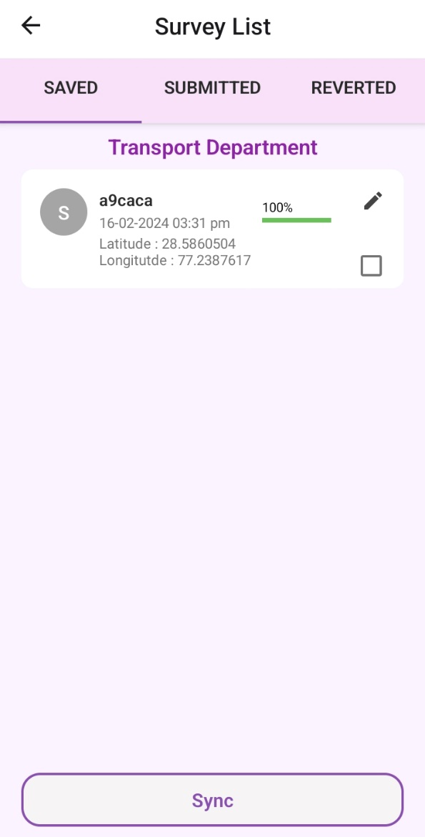
For example, if there are no saved surveys in Police Authority Surveys, you will see blank
And there is save survey in transport department, it will look like this, you can sync it by clicking on the checkbox here.

Slide 29
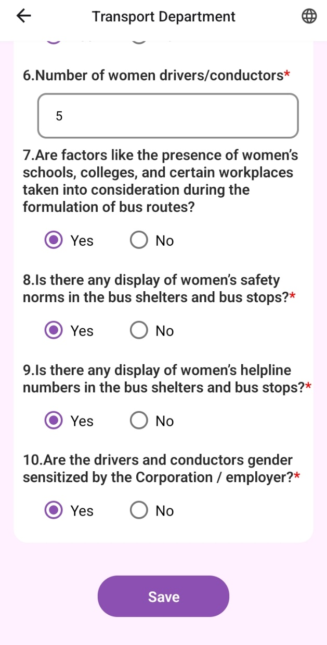
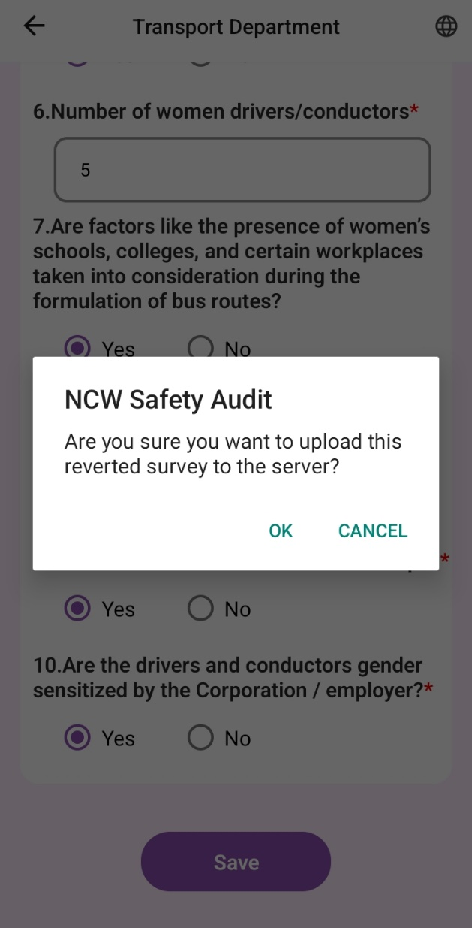
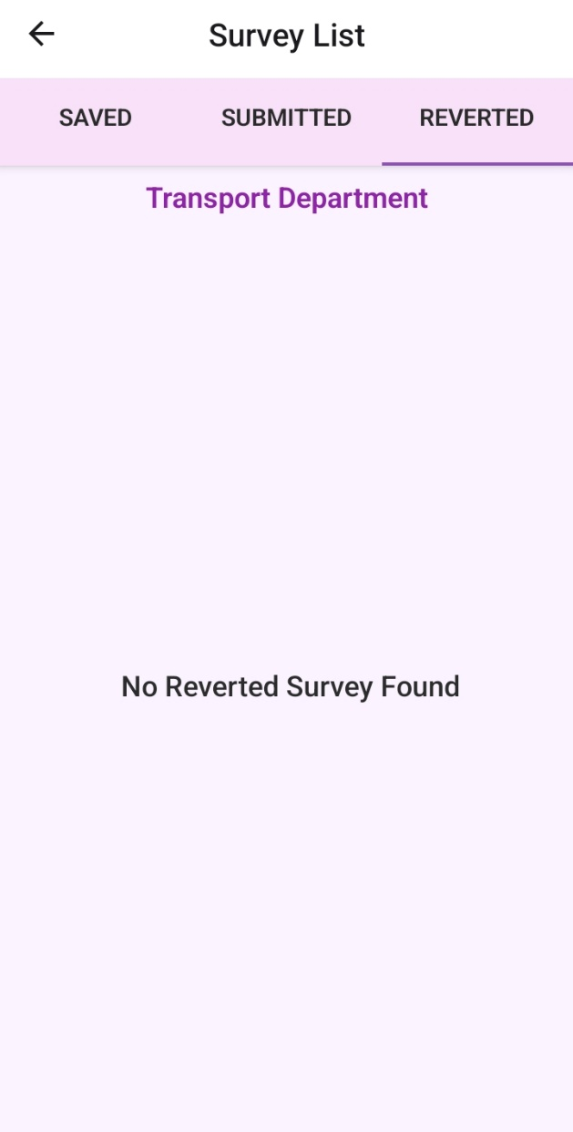
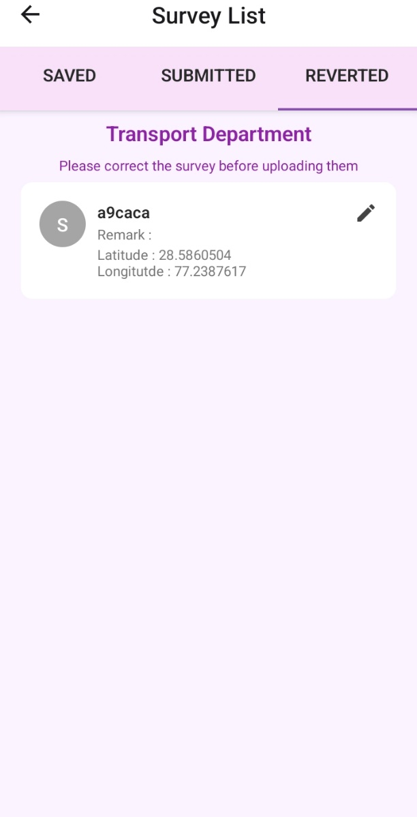
Reverted Survey- In the Reverted column, you will see surveys that have been returned to you by the agency admin (Principal Investigator) or data supervisor to correct the survey.
Note: The process of reverse survey can be edited online only.

Slide 30
Thank You

