Slide 1
Counselling- Details Counselling Process is described below
    Counselling Registration
      Counselling Type
      Problem Summary
      Victim details
    Add Family Members (Call this page from Level 3 when counselling session is activated and show call button in list of family member in other case hide the call button)
Add Form for Family Member
List of family member
    Schedule Counselling Session
(Ask) Caller Preferable Date Time

Slide 2
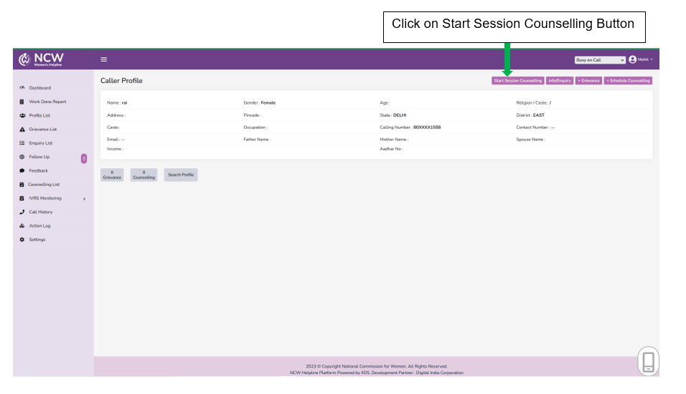
On The Call Counselling – In this counseling, the victim can be counseled during the call.

Slide 3
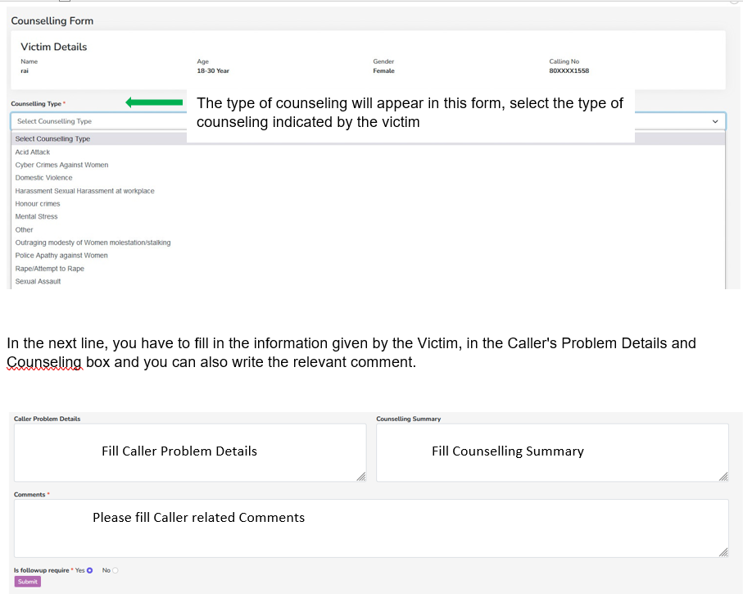
After pressing the Start Session Counseling button the counseling form will open.

Slide 4
Schedule Counselling- In schedule counseling button, the call attendant can schedule the counseling of the caller/victim for some other day.
These are the steps behind the schedule counselling
Show counselling type
Choose Counsellor
Choose Victim & family member from the list (Multi choice)
Show calendar of the selected counsellor

Slide 5
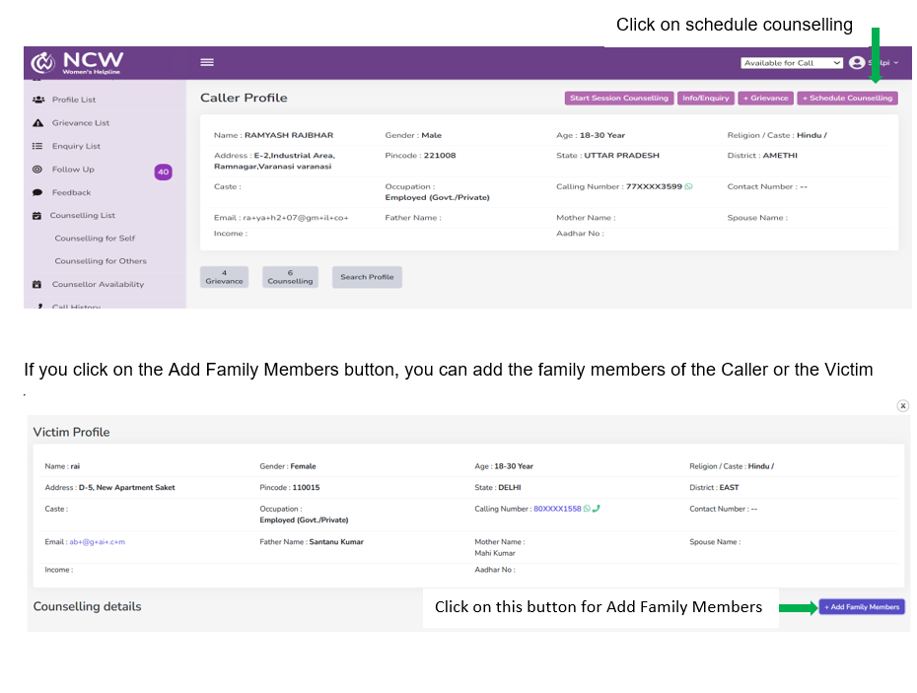

Slide 6
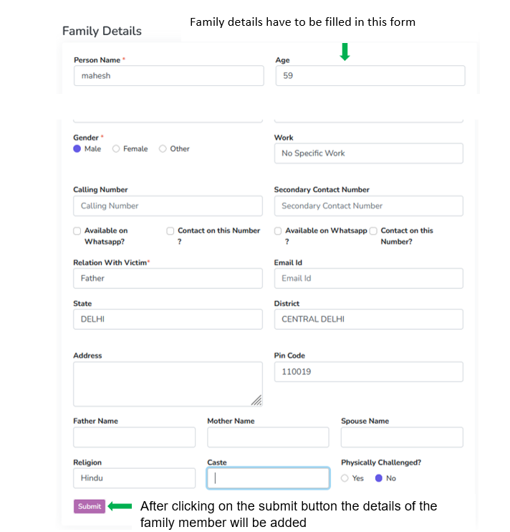
After clicking on the Add Family Member button, the form to add a family member button will be open, where you will have to fill the details of the family member. And you can also add more family members.
Showing this form Click after Add Family Members Button

Slide 7
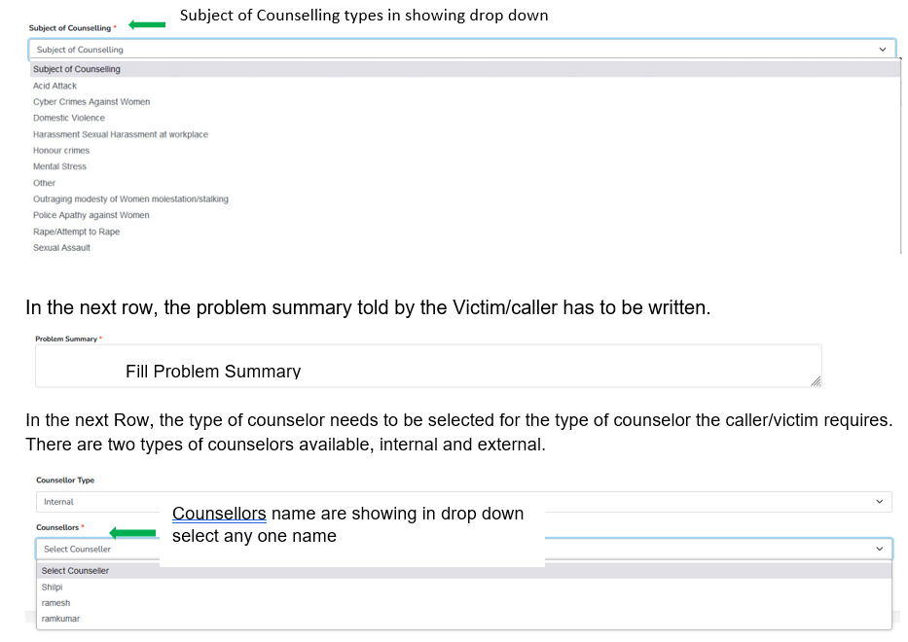
In the next row, the subject of counseling mentioned by the Victim/caller has to be selected.

Slide 8
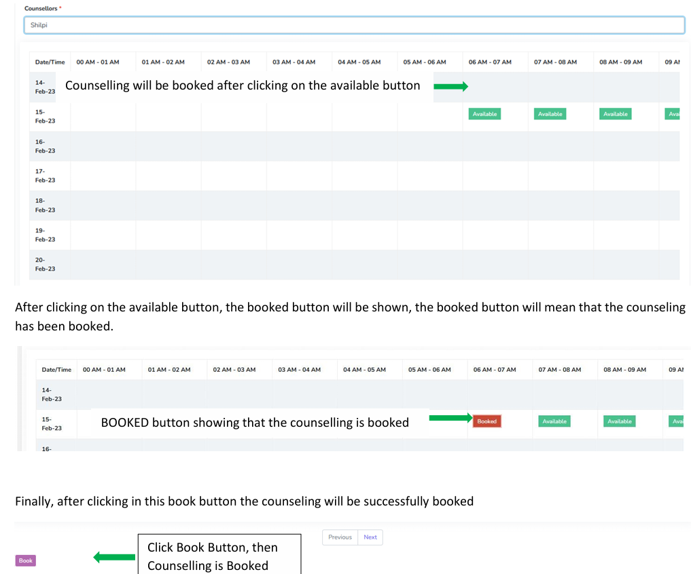
After selecting one of the counselors, the system will show you a calendar with details on whether the counselor is available or not. And the time will also be shown in this calendar by which the counseling session will be booked for the Victim/caller. For that click on the available button

Slide 9
In Counselor Availability, you can see at what time and on what date the counselor is available.
By default, the counsellor is available in his/her shift when his/her shift is added. Otherwise, Admin can change or mark their availability from here.

Slide 10
Follow Up - Follow up will be done differently with the caller, service provider, counsellor. After registering the grievance, and counselling session the follow up on that call will be required or not that will be decided by the call attendant and counsellor. In case of grievance, the call attendant has to decide whether follow up is required with the caller and service provider
Follow up with the caller - By default call to victim after 24 h and can enter the variable time.
Follow-Up Time Guidelines-
Categories default follow up time
Cyber-crimes against women - 4 h
Rape / Attempt to rape - 2 h
Acid Attack - 2 h
Sexual Assault - 24 h
Sexual Harassment of women at workplace - 24 h
Outraging modesty / Molestation - 24 h
Domestic Violence/dowry harassment - 24 h
Police apathy - 24 h
Choice in marriage / Honour Crimes - 8 h
Mental Stress - 24 h

Slide 11
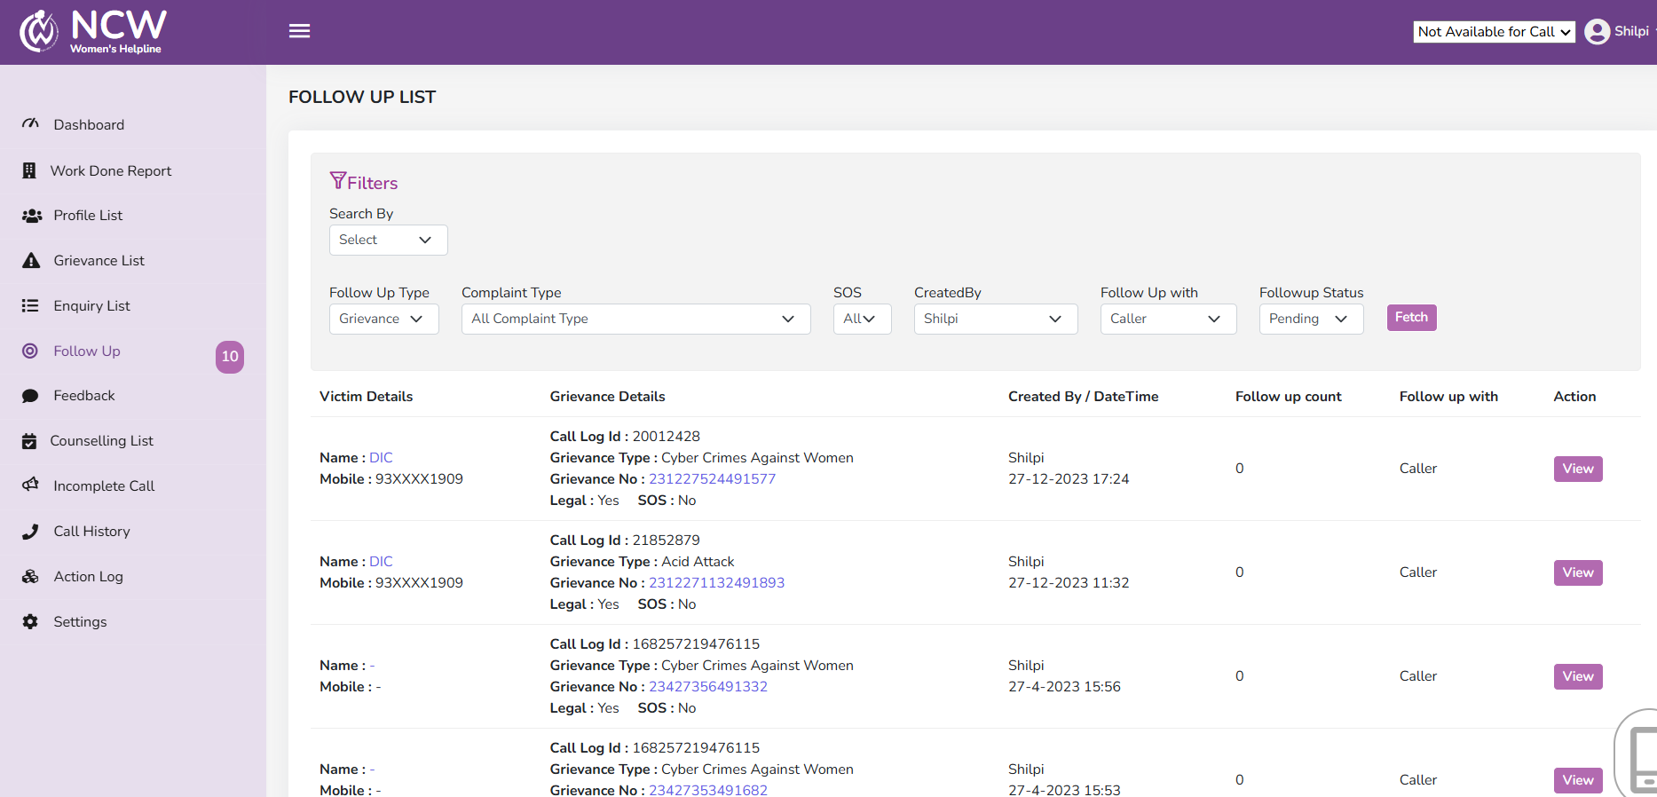

Slide 12
Feedback
All follow-ups call which is close will come to feedback Bucket.
• From the feedback bucket we will send the IVR Auto call to all numbers which is listed on that day within 36 hours.
• Feedback call will be in working hours from 9:00 AM to 6:00 PM.
• Call will be trigger in one mobile number if this call is received then no action is taken, in the case of call is not received then IVR will try two times and after all three attempts this list will be no response bucket.
• In Feedback call one question will be asked. IVRS feedback Question: Please rate your experience on a scale of 1 to 5.
Press 1 if you’re extremely dis-satisfied and press 5 if you’re highly satisfied.

Slide 13
