Slide 1

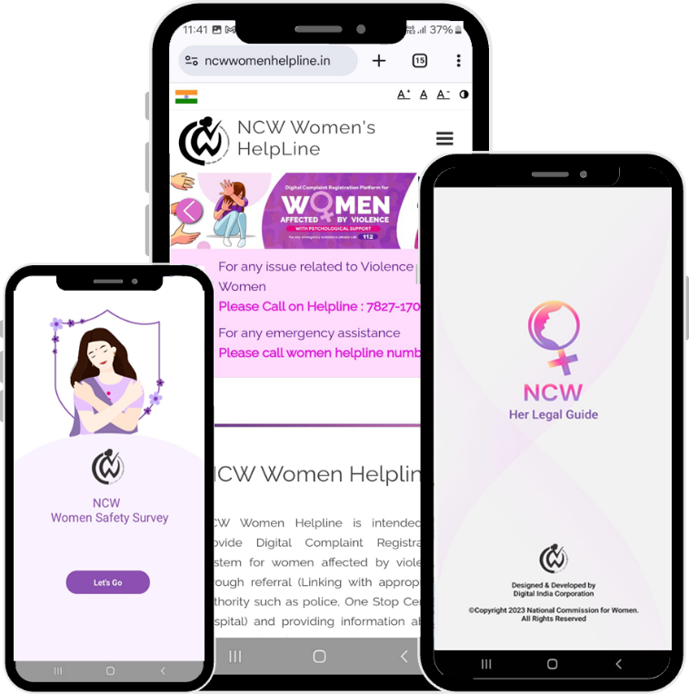
NCW 24*7 Women Helpline

Slide 2
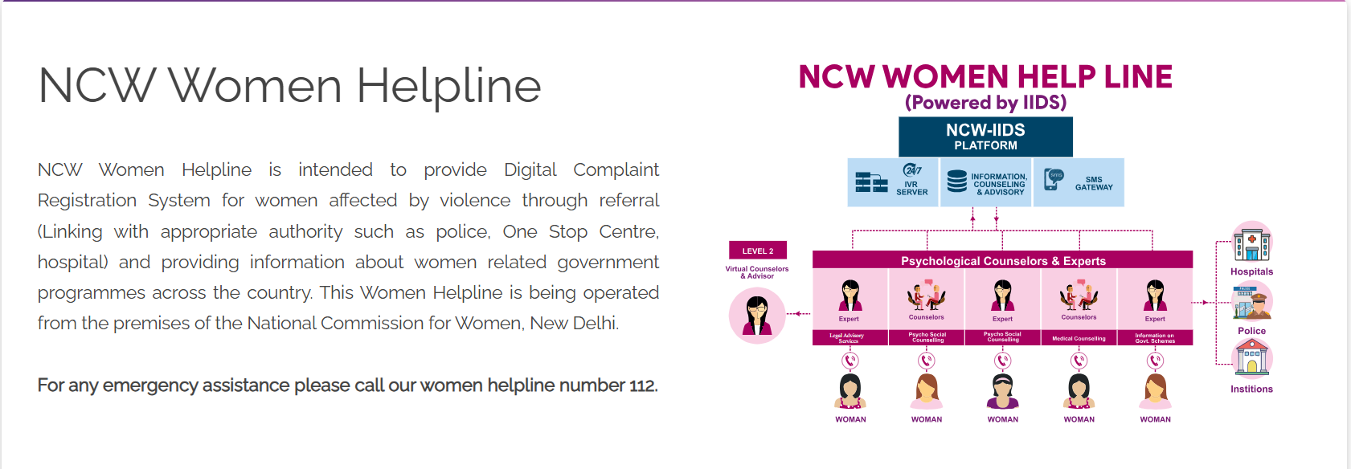


Slide 3
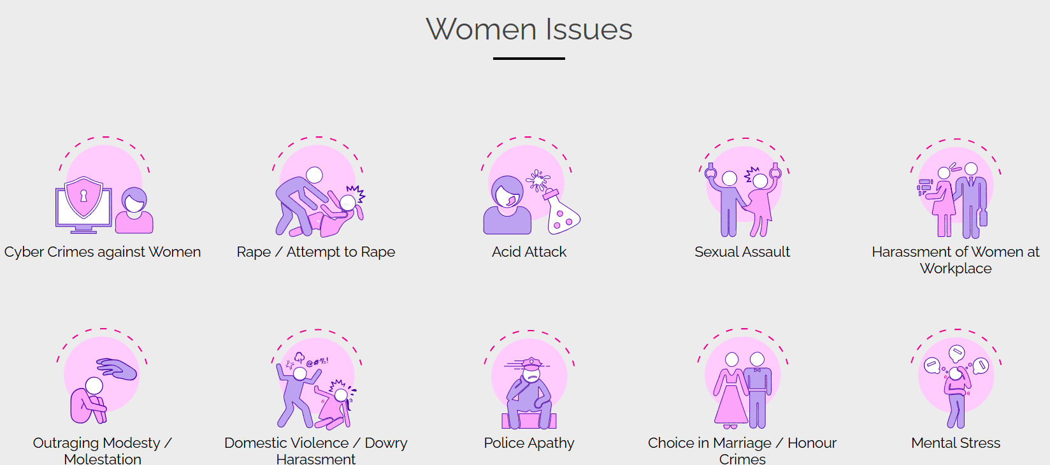

Slide 4
Website URL- https://www.ncwwomenhelpline.in/
Overview- NCW Women Helpline is intended to provide Digital Complaint Registration System for women affected by violence through referral (Linking with appropriate authority such as police, One Stop Centre, hospital) and providing information about women related government programmes across the country. This Helpline is being operated from the premises of the National Commission for Women, New Delhi.
The following type of categories are available in this portal, in which action can be taken
● Acid Attack
● Sexual Assault
● Harassment of women at workplace
● Outraging modesty / Molestation
● Rape / Attempt to rape
● Domestic Violence/dowry harassment
● Police apathy
● Choice in marriage / Honour Crimes
● Mental Stress
Users of the Application
Admin
Level 1 (Call Attendant / Call Attendant cum counsellor)
level 3 (JTE Counsellors)

Slide 5
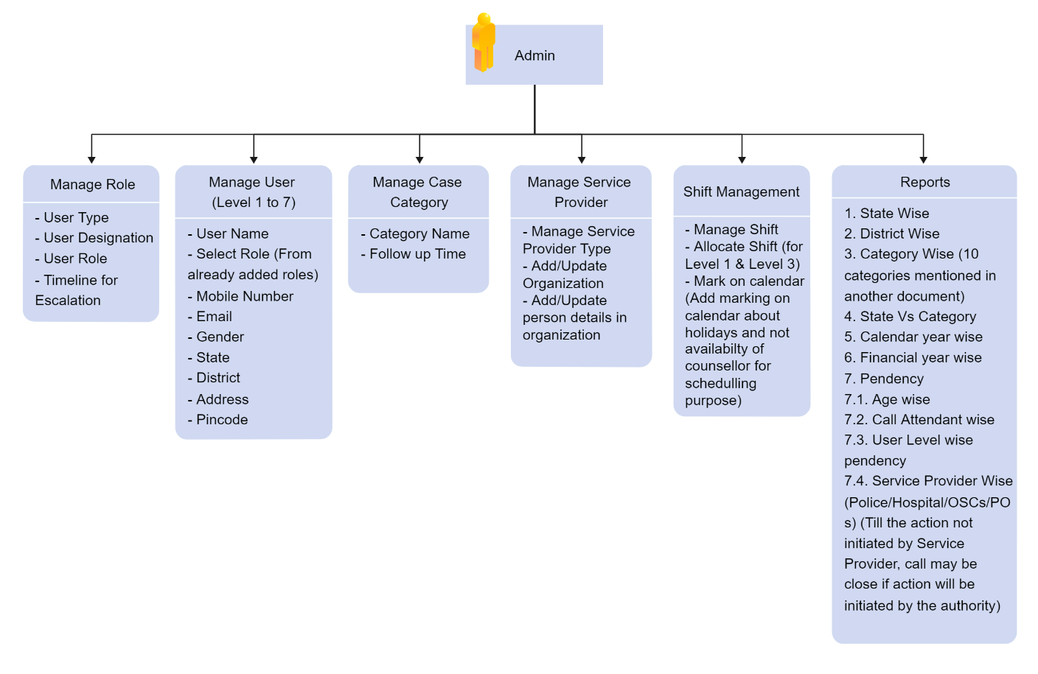
Website URL- https://www.ncwwomenhelpline.in/
Admin Module - Dashboard for Admin
Overview- NCW Women Helpline is intended to provide Digital Complaint Registration System for women affected by violence through referral (Linking with appropriate authority such as police, One Stop Centre, hospital) and providing information about women related government programmes across the country. This Helpline is being operated from the premises of the National Commission for Women, New Delhi.
The following type of categories are available in this portal, in which action can be taken
● Acid Attack
● Sexual Assault
● Harassment of women at workplace
● Outraging modesty / Molestation
● Rape / Attempt to rape
● Domestic Violence/dowry harassment
● Police apathy
● Choice in marriage / Honour Crimes
● Mental Stress

Slide 6
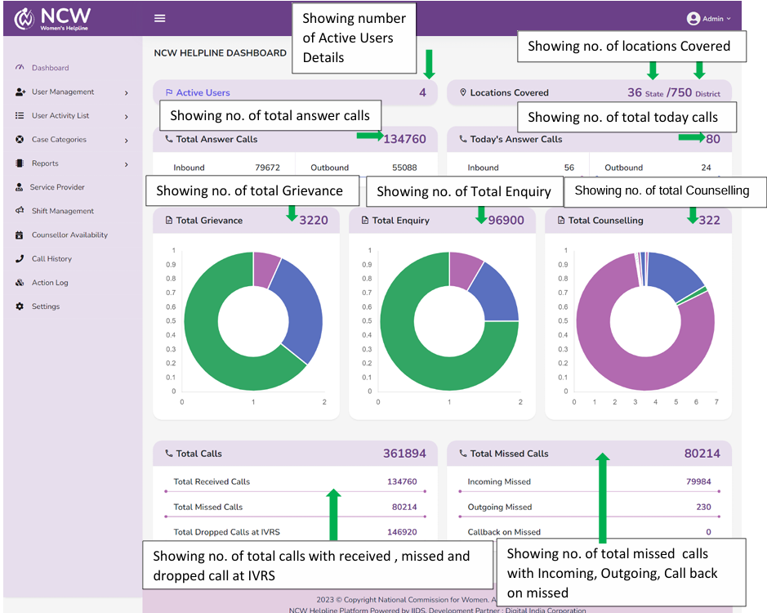

Slide 7
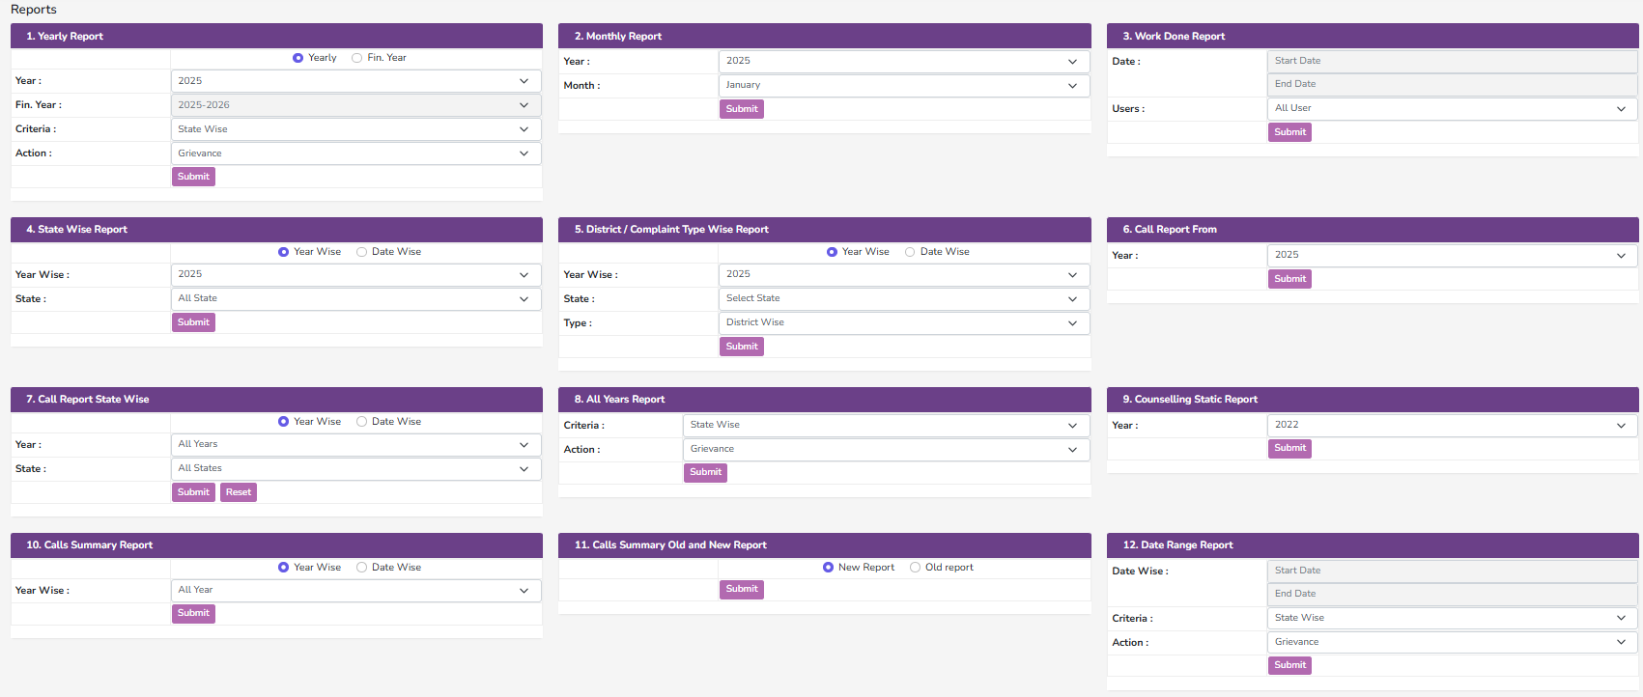
Reports

Slide 8
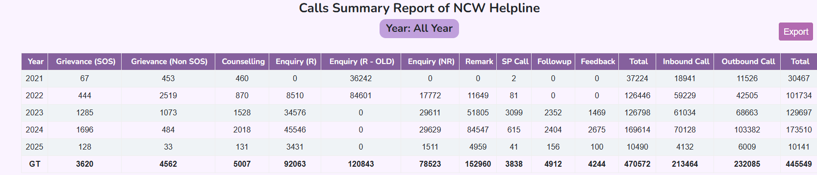
Calls Summary Report

Slide 9
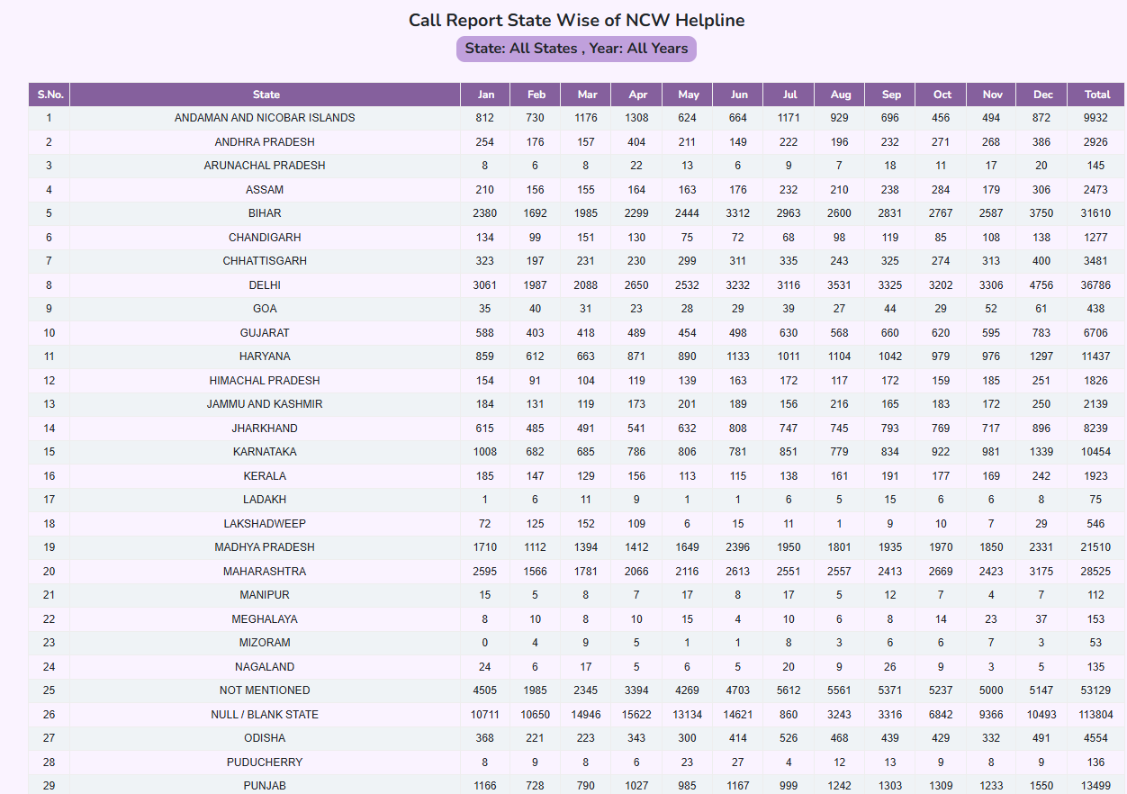
Website URL- https://www.ncwwomenhelpline.in/

Slide 10
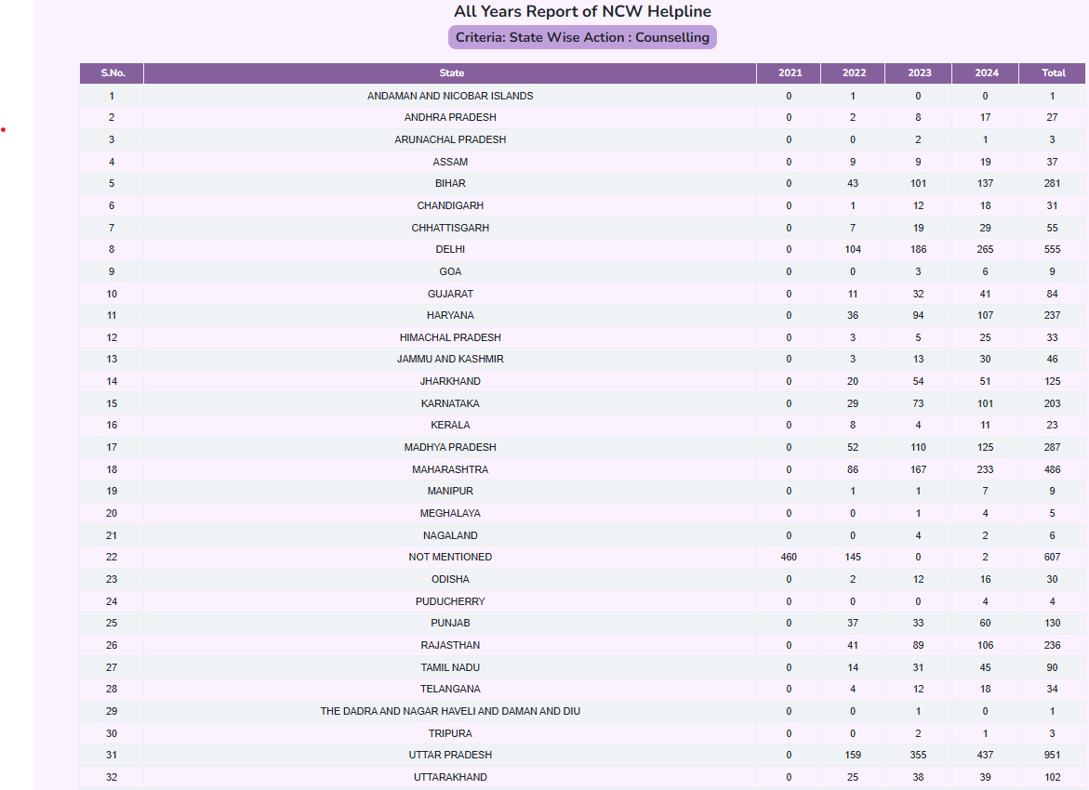

Slide 11
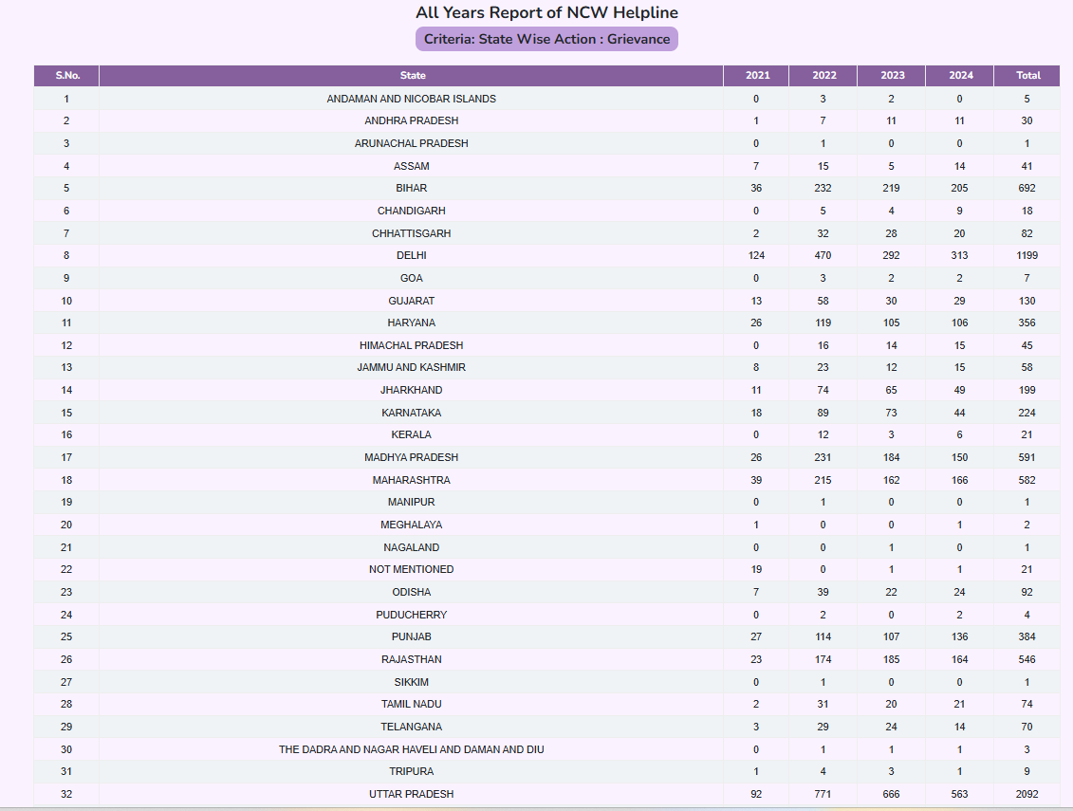
Website URL- https://www.ncwwomenhelpline.in/

Slide 12
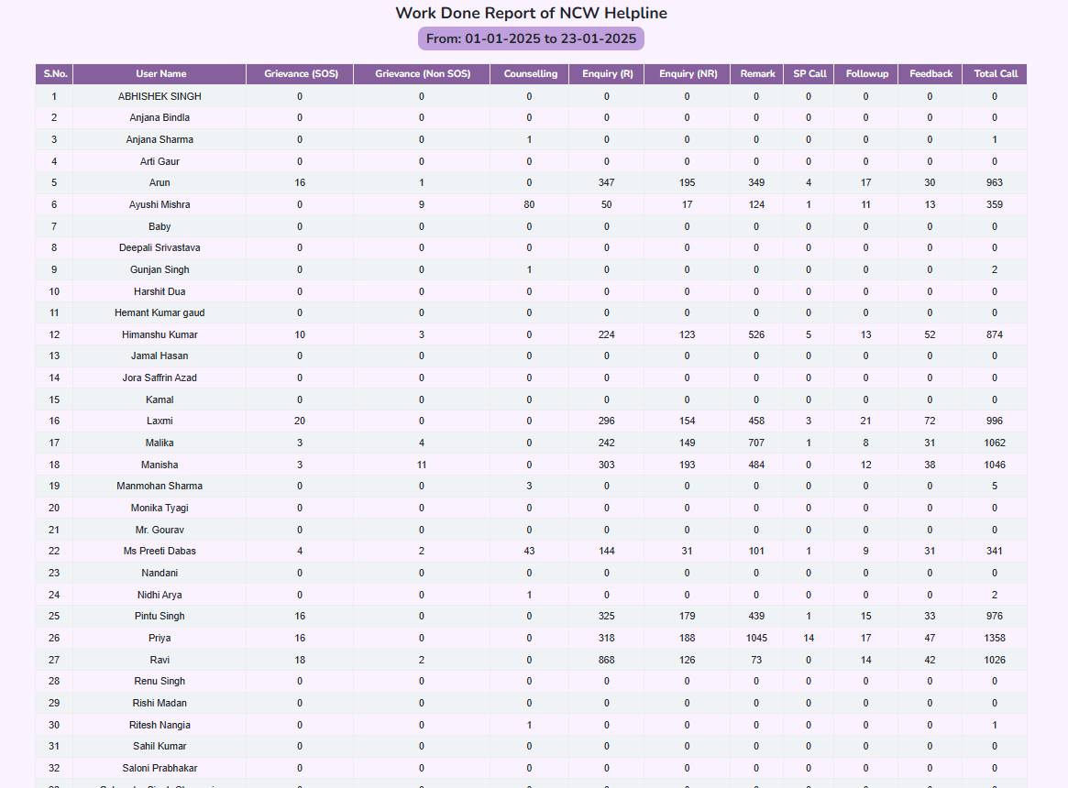
Website URL- https://www.ncwwomenhelpline.in/

Slide 13
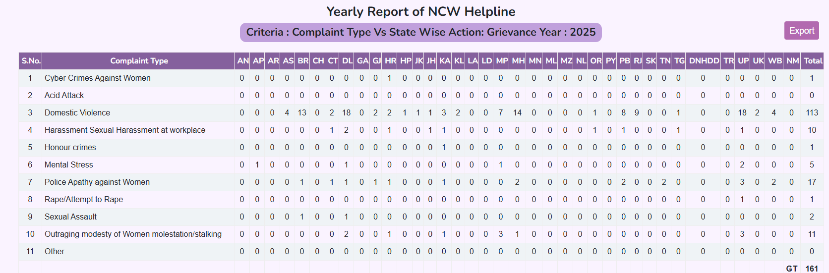

Slide 14
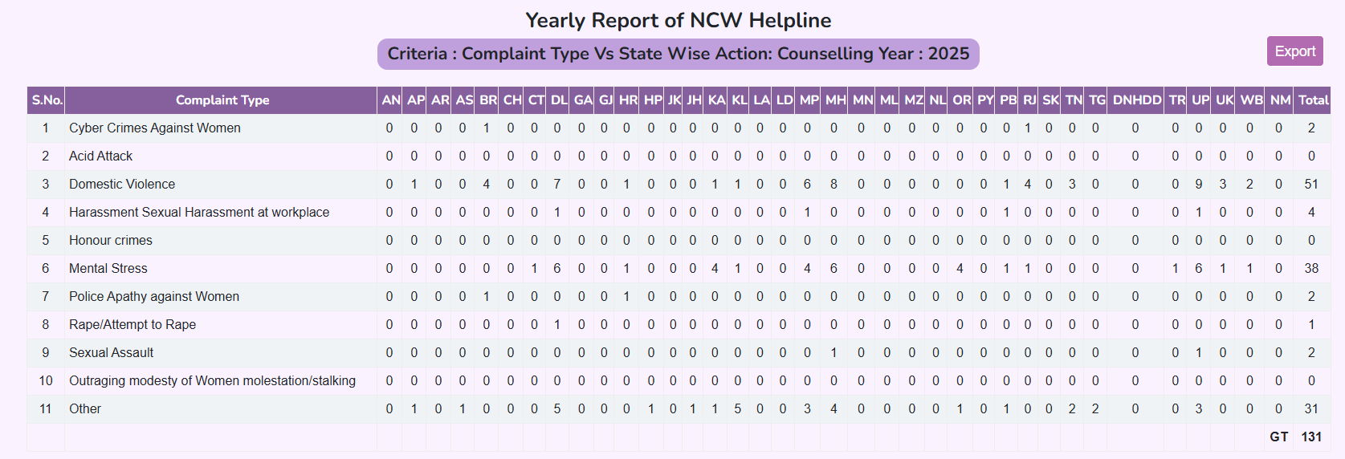
Website URL- https://www.ncwwomenhelpline.in/

Slide 15
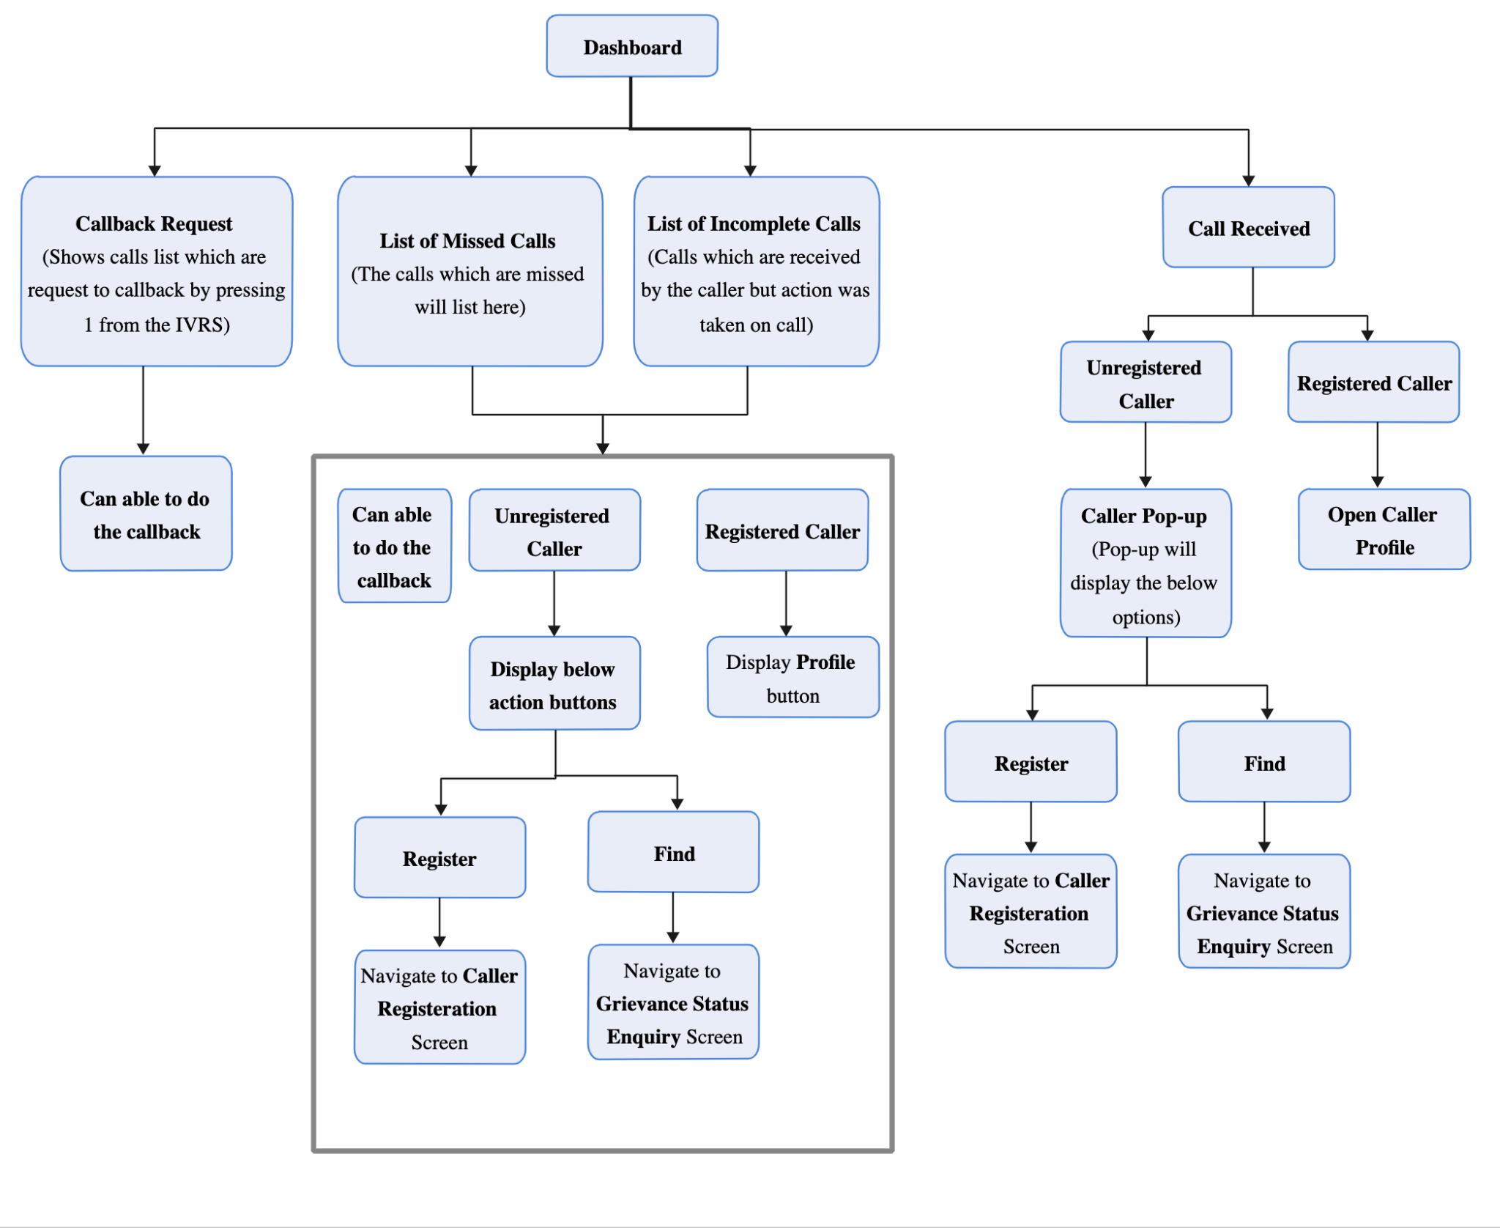
Call Attendant Module - Dashboard call Flow

Slide 16
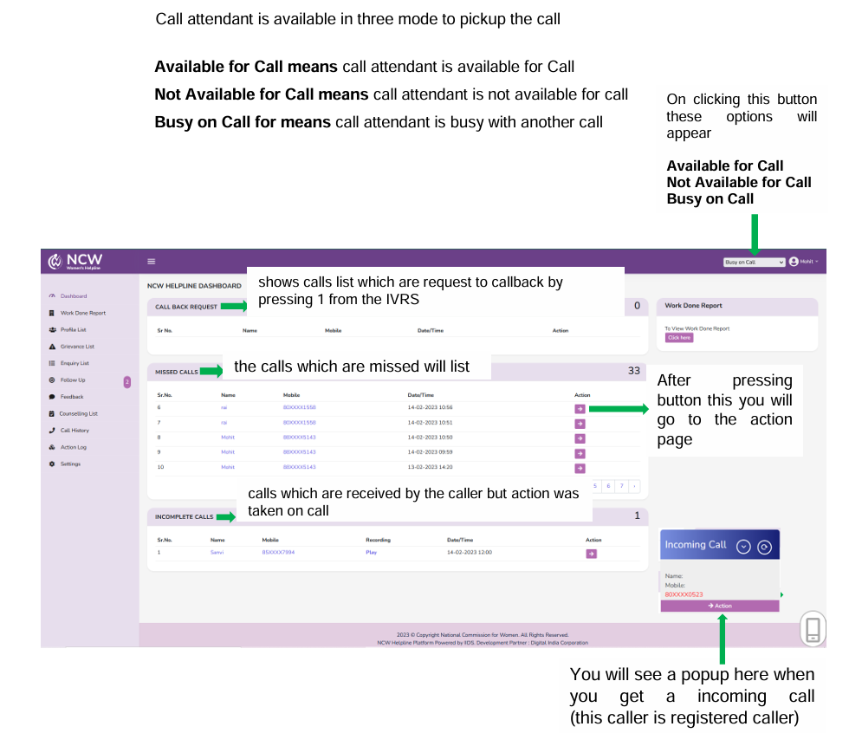
Caller Registration

Slide 17
Call Actions
There are some actions Listed below in the system. For the calls against which these actions are taking.
Grievance
Counselling
Enquiry
General enquire
Not related to NCW
Feedback
Follow ups

Slide 18
Action Grievance
A Grievance is a formal complaint that is raised by a Victim or Caller.
For the grievance registration, after the profile registration with basic details Call attendant enter the other mandatory details in the caller profile and according to the caller decide the category of the grievance and the fill the grievance form details based on the category.
Grievance Registration Process If caller like to registering complaint, select in drop down menu yes, then open Grievance Registration Form

Slide 19
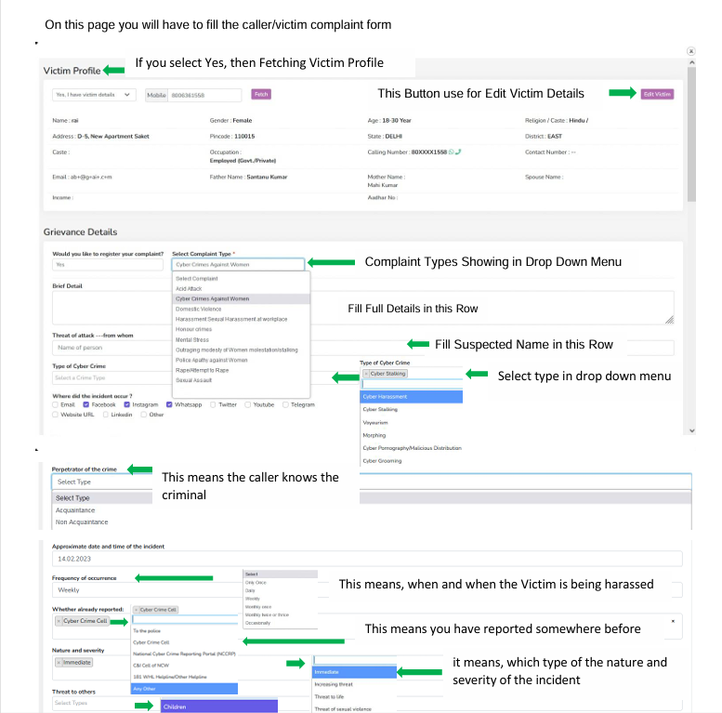

Slide 20
Grievance Registration Flow
Action Counselling
Details Counselling Process is described below
    Counselling Registration
      Counselling Type
      Problem Summary
      Victim details
    Add Family Members (Call this page from Level 3 when counselling session is activated and show call button in list of family member in other case hide the call button)
Add Form for Family Member
List of family member
    Schedule Counselling Session
(Ask) Caller Preferable Date Time

Slide 21
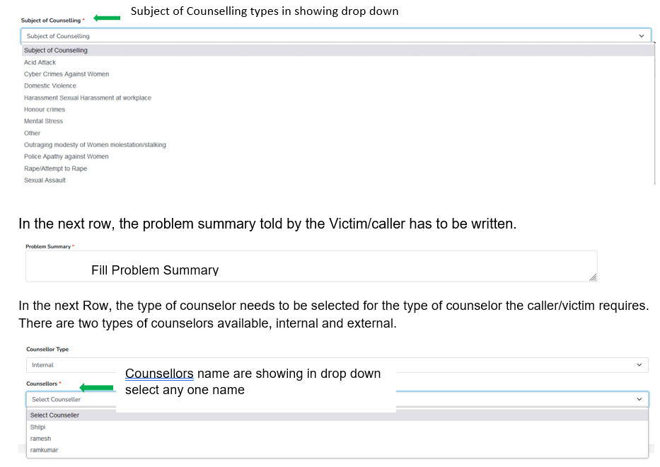
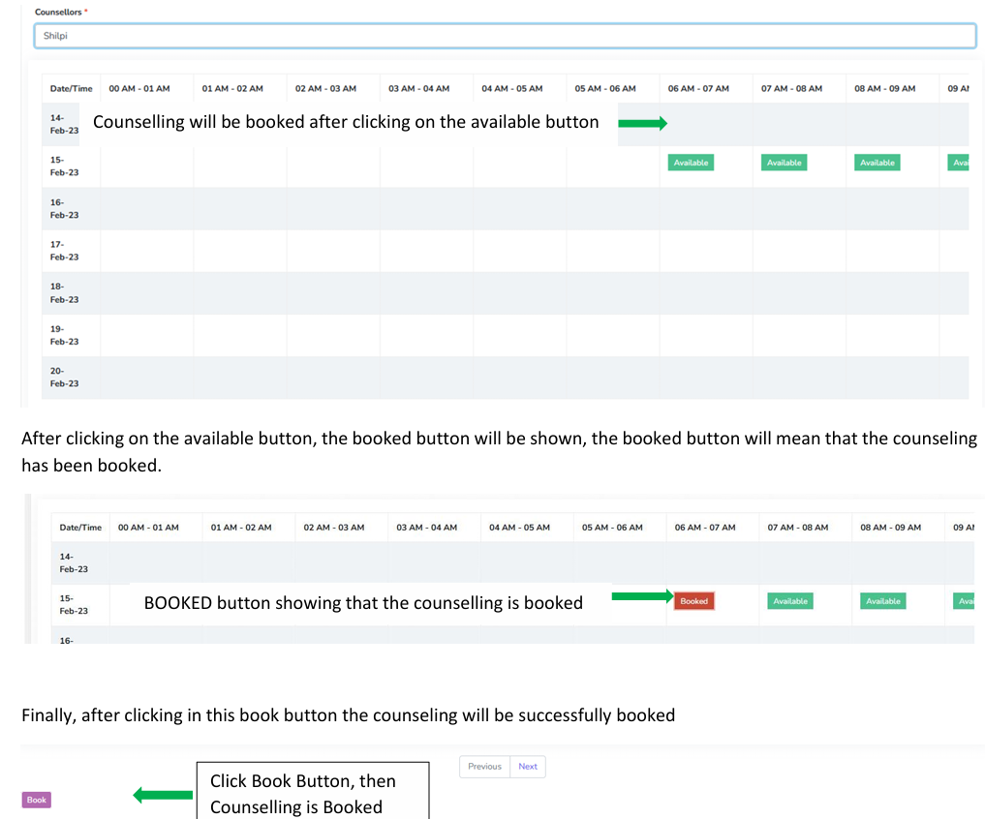
Counselling Form

Slide 22
Action Follow ups
Follow Up - Follow up will be done differently with the caller, service provider.
After registering the grievance, and counselling session the follow up on that call will be required or not that will be decided by the call attendant and counsellor.
In case of grievance, the call attendant has to decide whether follow up is required with the caller and service provider.
  Follow up with the caller. - Call to victim after 24 h
  Follow up with service provider –
  Categories default follow up time
  Cyber-crimes against women - 4 h
  Rape / Attempt to rape - 2 h
  Acid Attack - 2 h
  Sexual Assault - 24 h
  Sexual Harassment of women at workplace - 24 h
  Outraging modesty / Molestation - 24 h
  Domestic Violence/dowry harassment - 24 h
  Police apathy - 24 hs
  Choice in marriage / Honour Crimes - 8 h
  Mental Stress - 24 h
  Actions on follow up -
Call close
Follow up
Follow up with higher authority
Call Close - In call close there are 2 cases as per the actions on call.
For enquiries action, will consider the call as close once the enquiry has been done.
For Grievance and counselling actions, call close will be manually marked by the all attendant as per the follow up taken with the caller, service provider and counsellor.

Slide 23
Action Feedback
In the case of grievance all calls after the closure call will be automatically gone for feedback while in other cases like counselling calls, if required, it will be manually triggered by the counsellor at the time of closure of call.
All follow-ups call which is close will come to feedback Bucket.
• From the feedback bucket we will send the IVR Auto call to all numbers which is listed on that day within 36 hours.
• Feedback call will be in working hours from 9:00 AM to 6:00 PM.
• Call will be trigger in one mobile number if this call is received then no action is taken, in the case of call is not received then IVR will try two times and after all three attempts this list will be no response bucket.
• In Feedback call one question will be asked. IVRS feedback Question: Please rate your experience on a scale of 1 to 5.
Press 1 if you’re extremely dis-satisfied and press 5 if you’re highly satisfied.

